Slide 1

AUDITORIUM
AUDIO-VIDEO
INSTALLATIONS

Slide 2
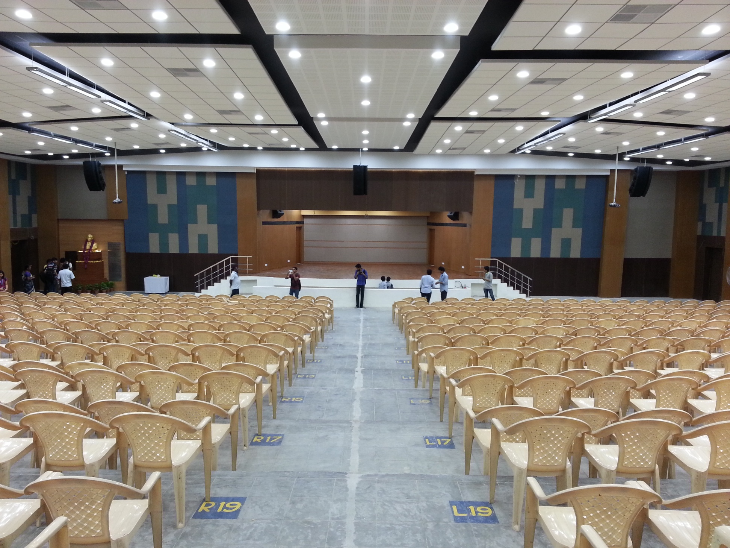
VIT UNIVERSITY
ANNA
AUDITORIUM
1800 seating capacity
A-An impressive sound delivered by JBL line Array System in LCR format.
JBL line Array Speakers are powered with Crown Amplifiers.
B-EPSON 10000 lumens projector installed on either side of the stage
C-12 x 9 motorized projector screen
A
C
A
B
A

Slide 3
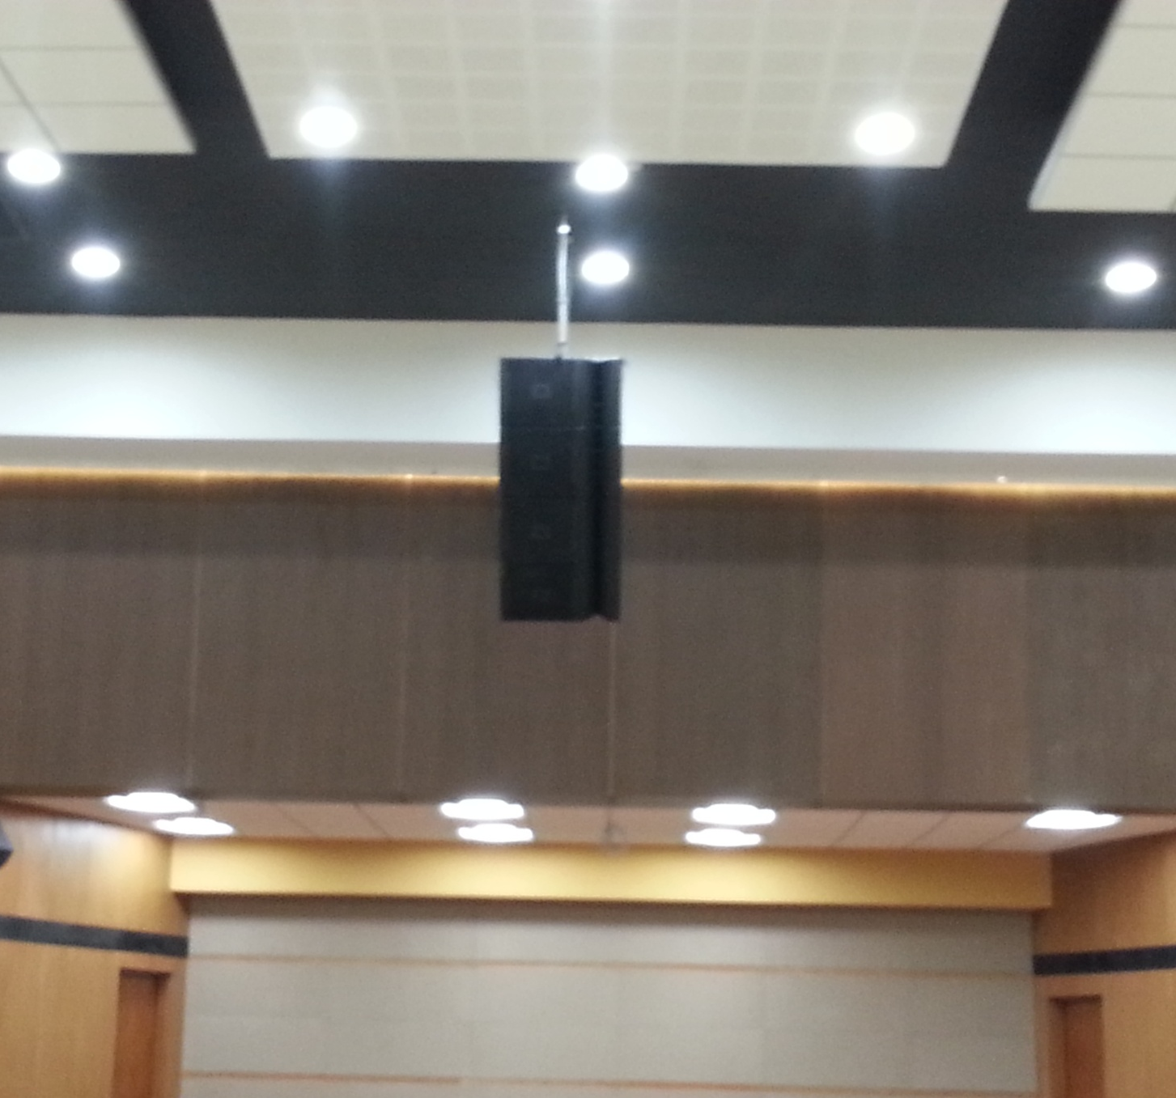
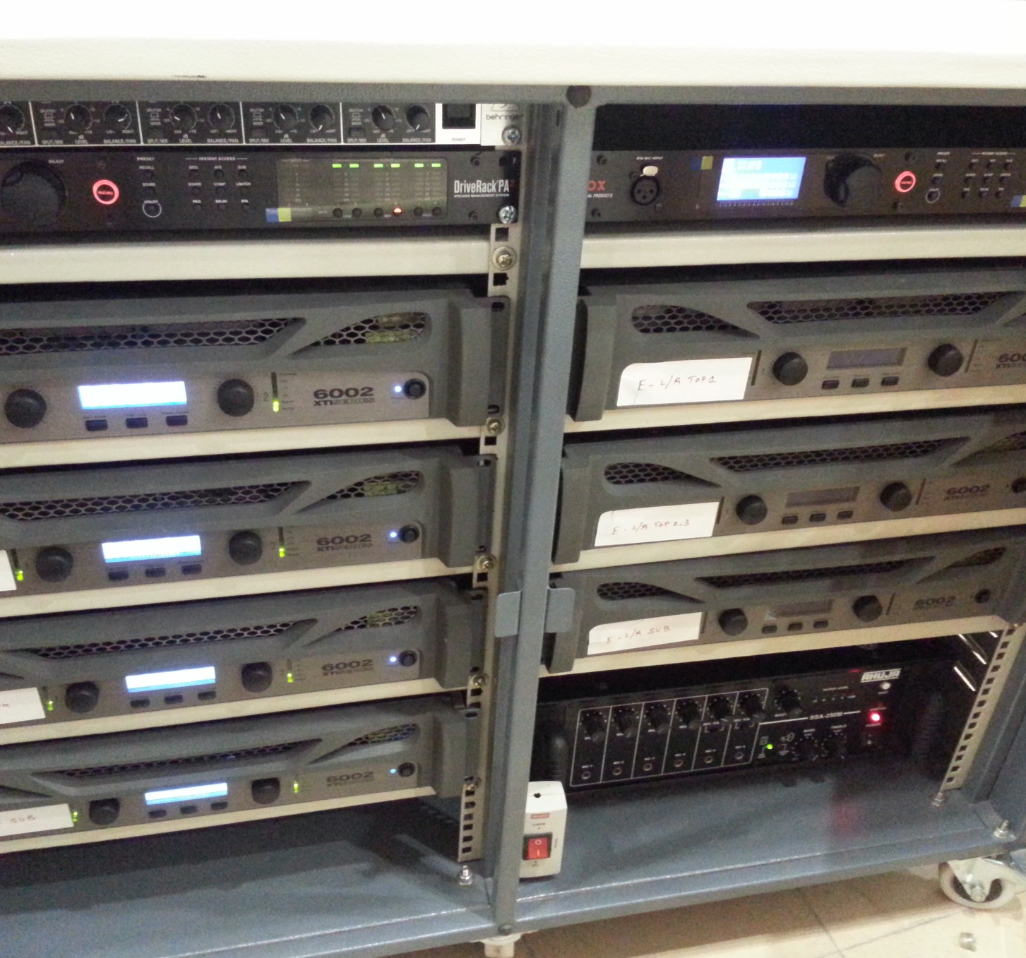
VIT ANNA AUDITORIUM
LINE ARRAY SPEAKER
AMPLIFIER RACK

Slide 4
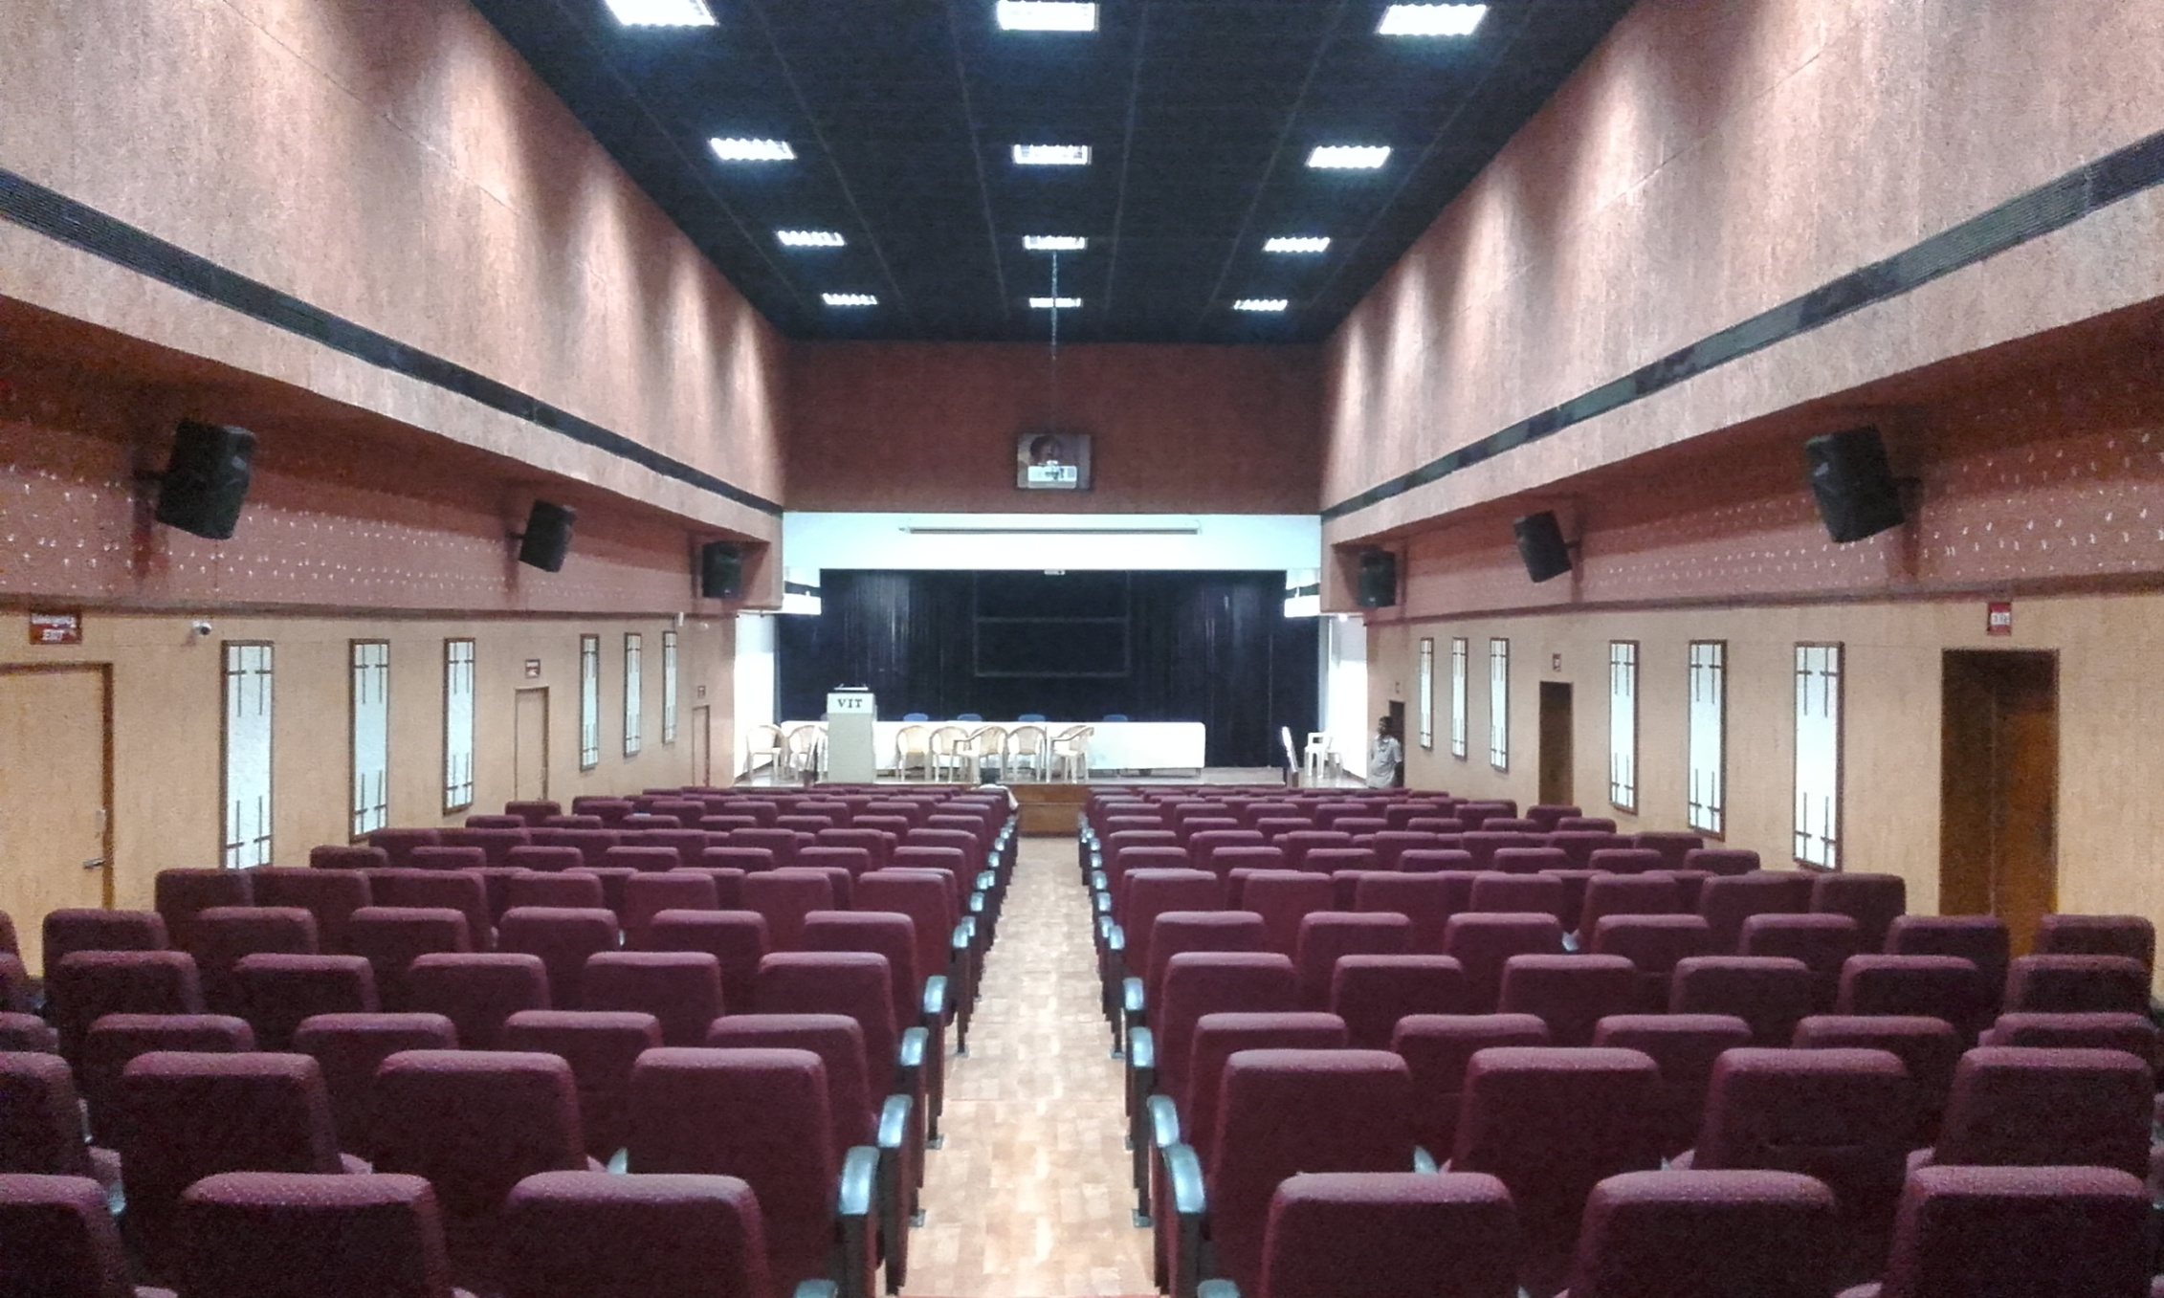
VIT UNIVERSITY CHENNA REDDY
AUDITORIUM
500 Seating capacity
A- Professional Audio Installation with
distributed speakers
B – Interactive Panel used at podium which is
connected to the projector
Sony LCD Projector Motorized screen used.
This Auditorium is an incredible combination of Acoustics and Sound Reinforcement for conferences.
A
B

Slide 5
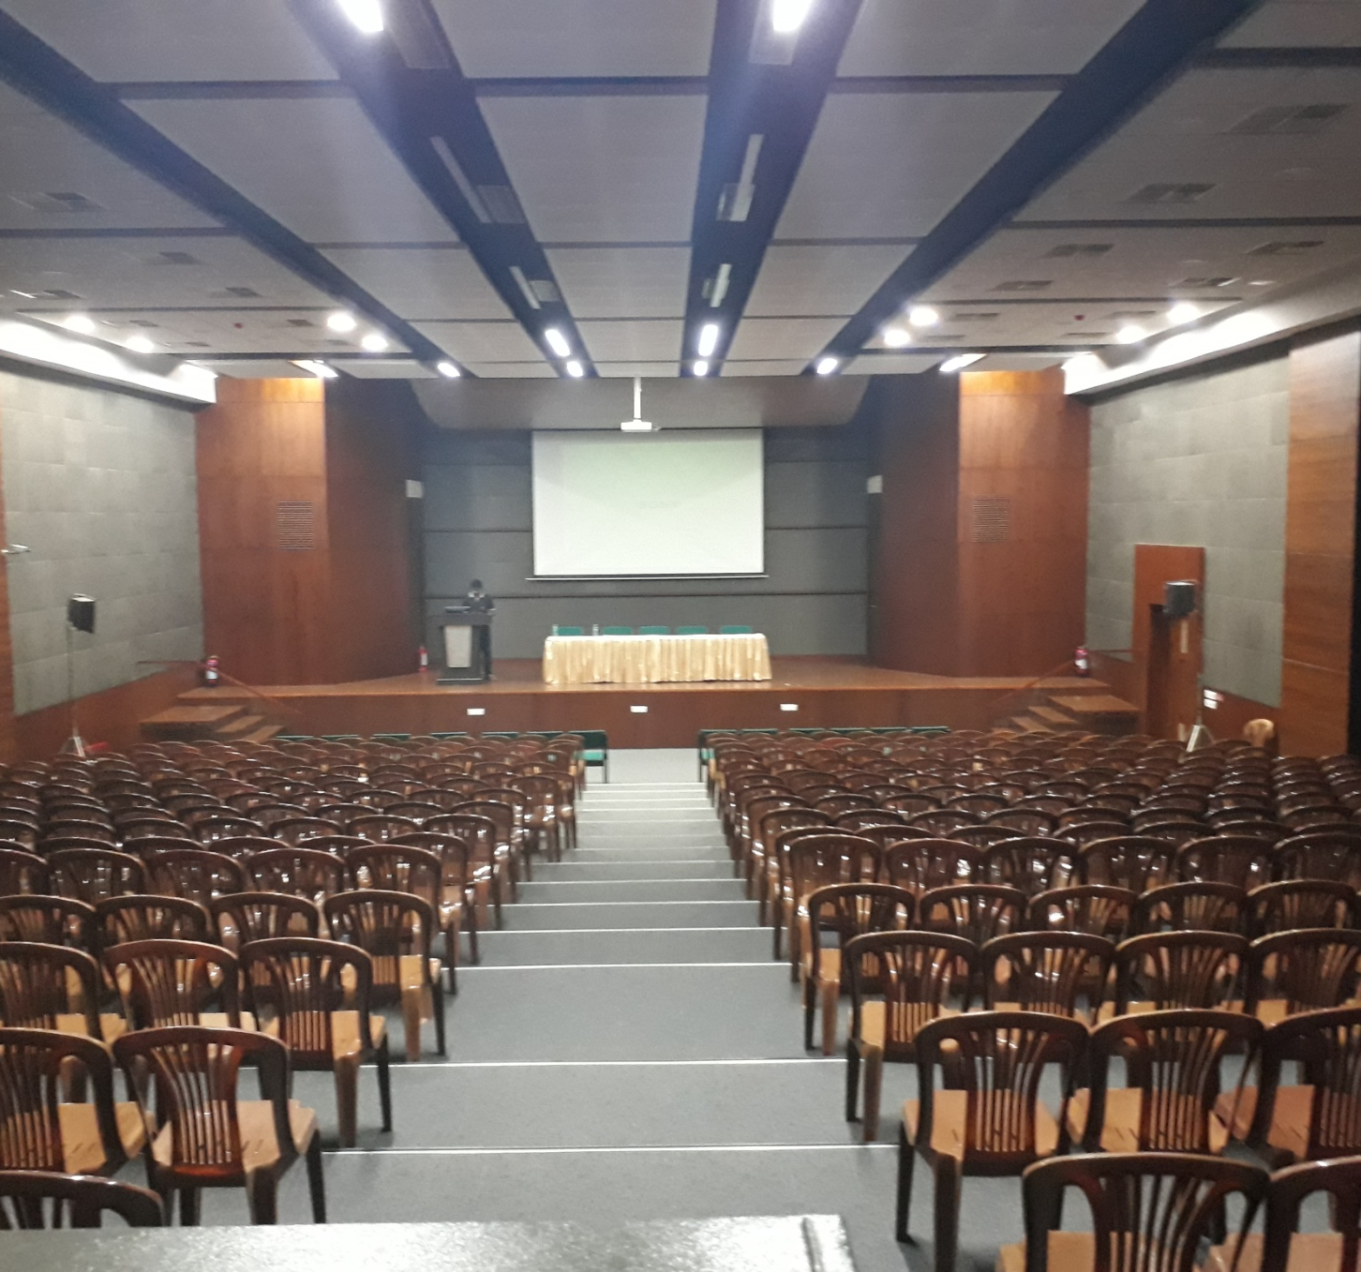
VIT CHENNAI
800 Seating capacity
A – JBL 3-way Speaker system Installed
inbuilt with Interiors powered with
Crown amplifiers an Allenheath
mixer board.
B – Sony 5000 Lumens LCD Projector
C – Elite 220” Diagonal 16:10 Motorised
Projector Installed
D – WACOM Interactive Panel used at
podium
B
A
C
D

Slide 6
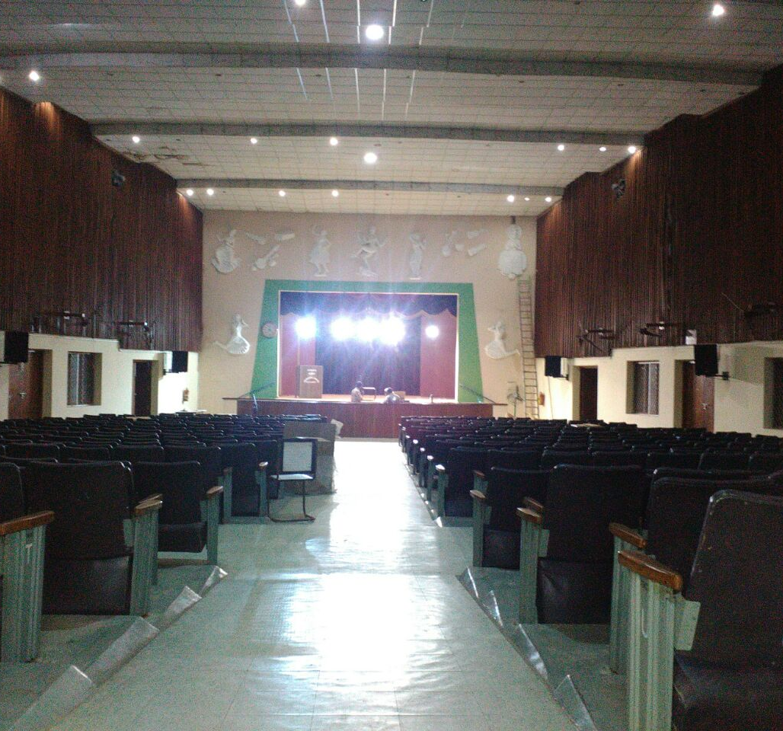
BHEL AUDITORIUM
1000 Seating capacity
Studiomaster Professional Audio
system Installed
Studiomaster 15” LF 2-way Speaker
system powered with Studiomaster
power amplifier and mixerboard
Auditorium used for conferences
and Theatre purpose.

Slide 7
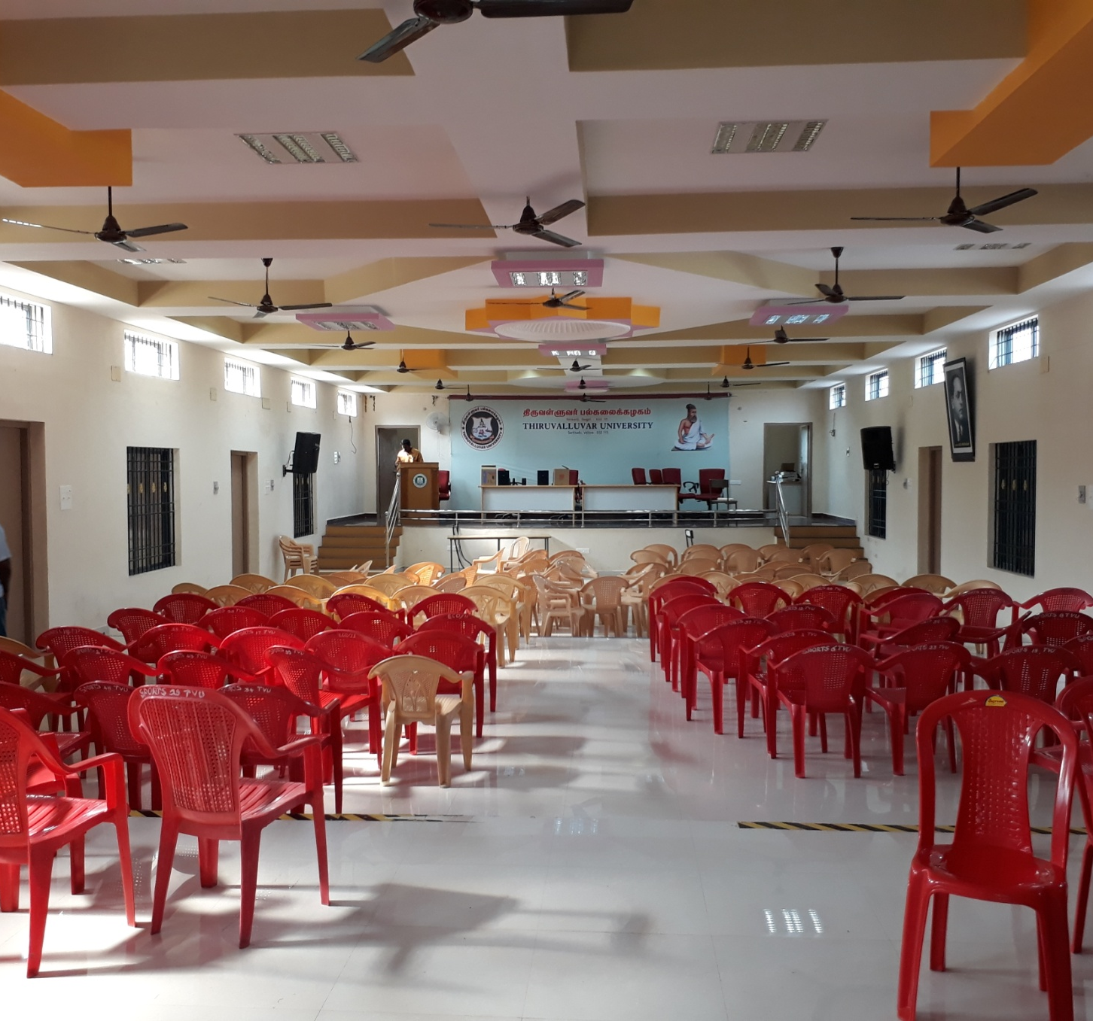
THIRUVALLUVAR UNIVERSITY
400 Seating Capacity
Ahuja Sound System Installed with 16 channel Mixer board,Ahuja 2-way Speakers and Power Amplifier.
Auditorium is used for conferences and
culturals.

Slide 8
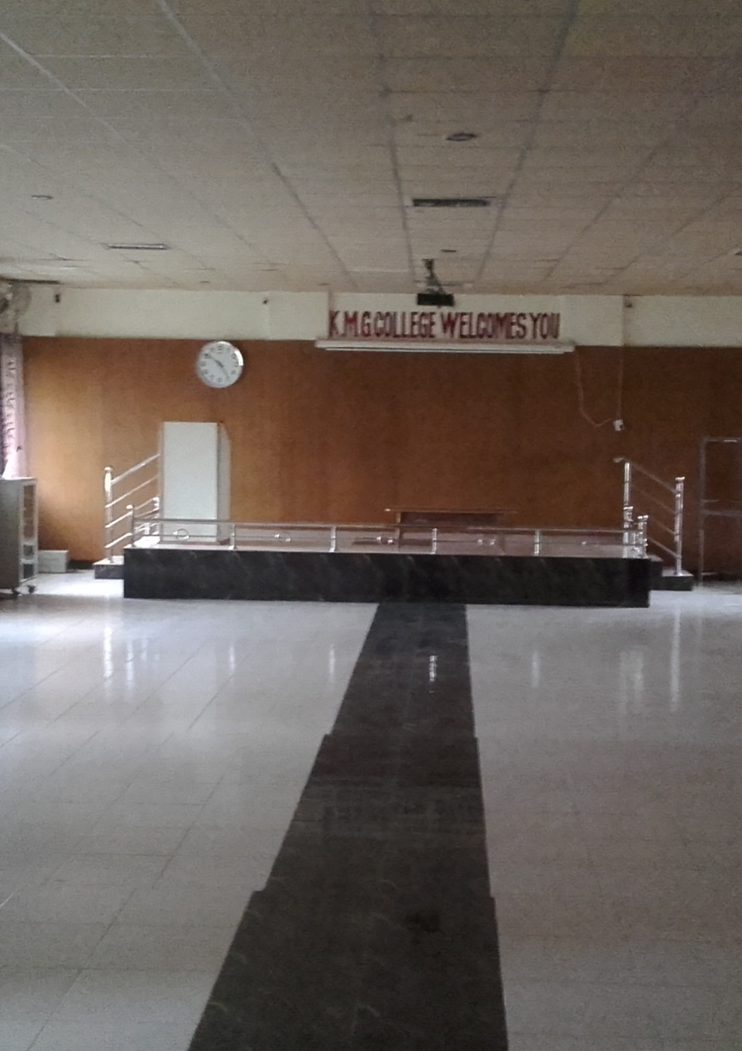
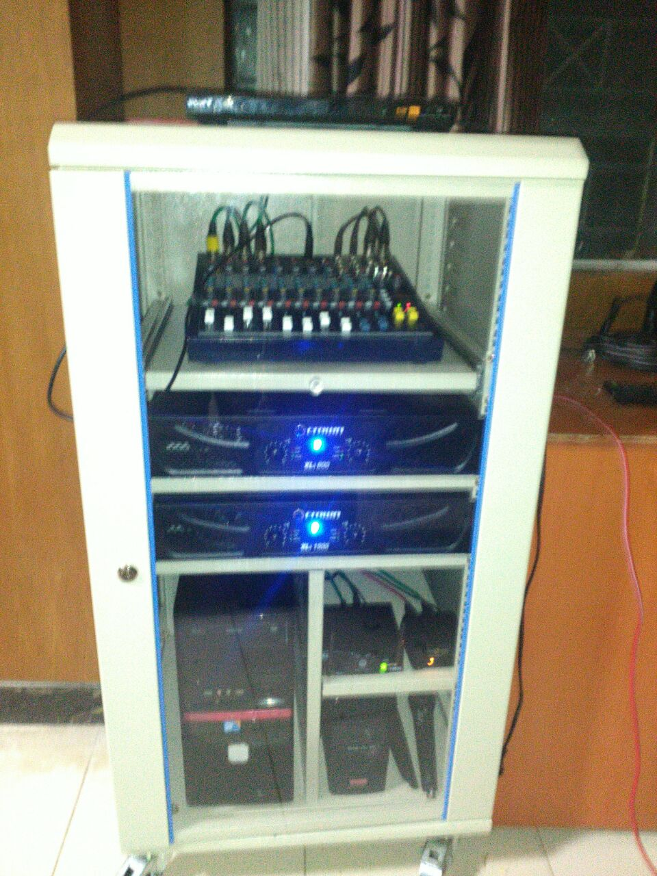
KMG COLLEGE
200 Seating Capacity
JBL control 29 AV Speakers,Crown Power Amplifiers and SoundCraft 8 channel mixer Board and Shure Microphones.
This AV Installation is used for Seminar purposes

Slide 9
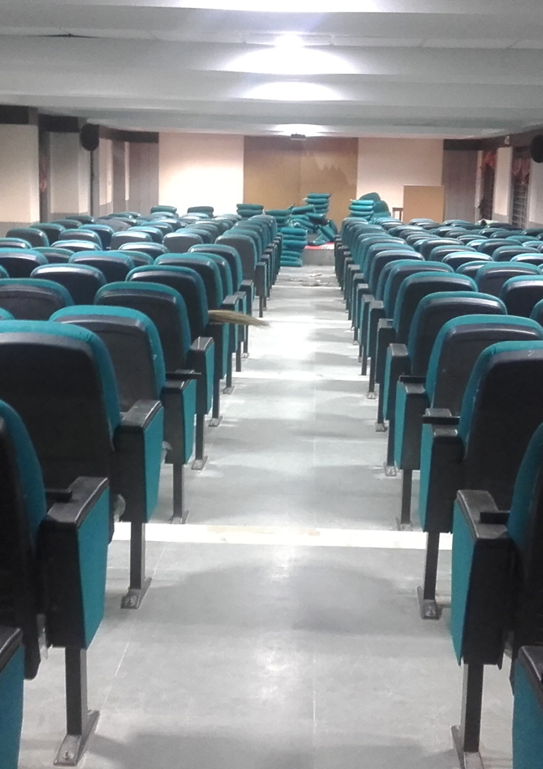
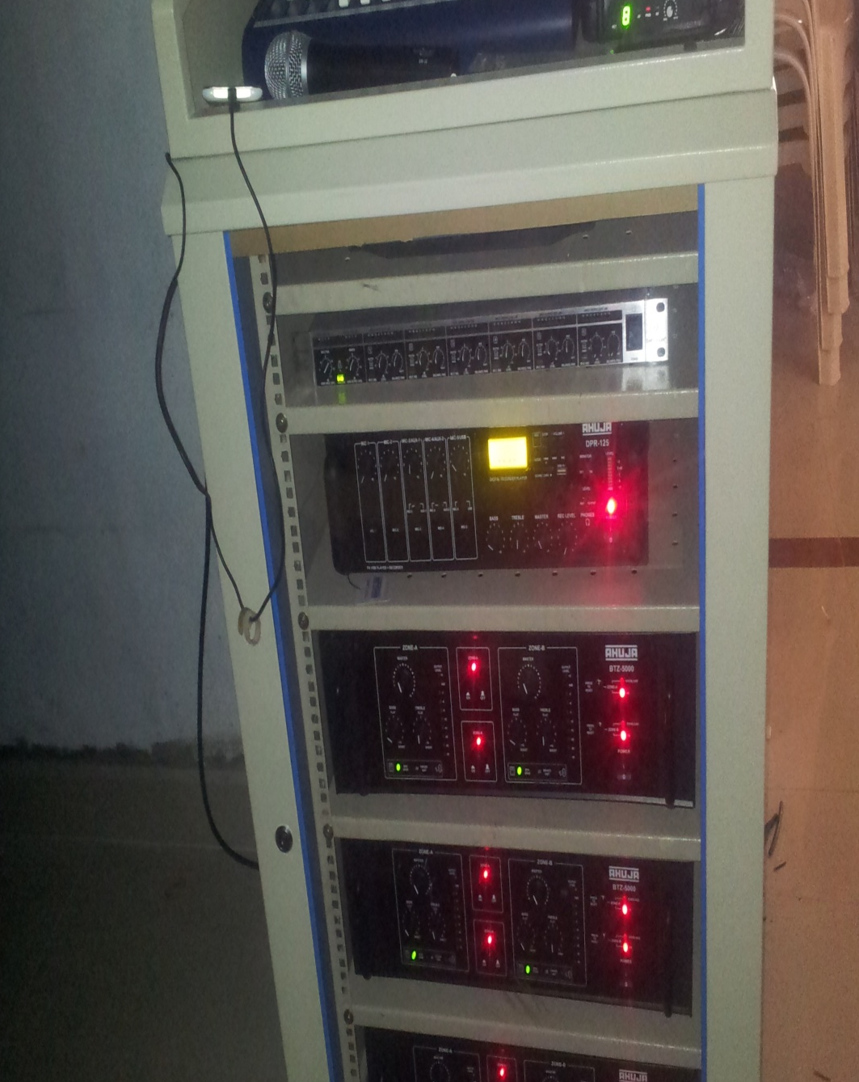
ETHIRAJ COLLEGE
CHENNAI
200 Seating Capacity
Electro voice Speakers with Ahuja Power Amplifiers and Studiomaster 8 channel mixer Board installed
The auditorium that experiences crystal clear audio delivery is used for conducting seminars and conferences.

Slide 10
THANK YOU

