Slide 1

CHURCH
AV
INSTALLATION

Slide 2
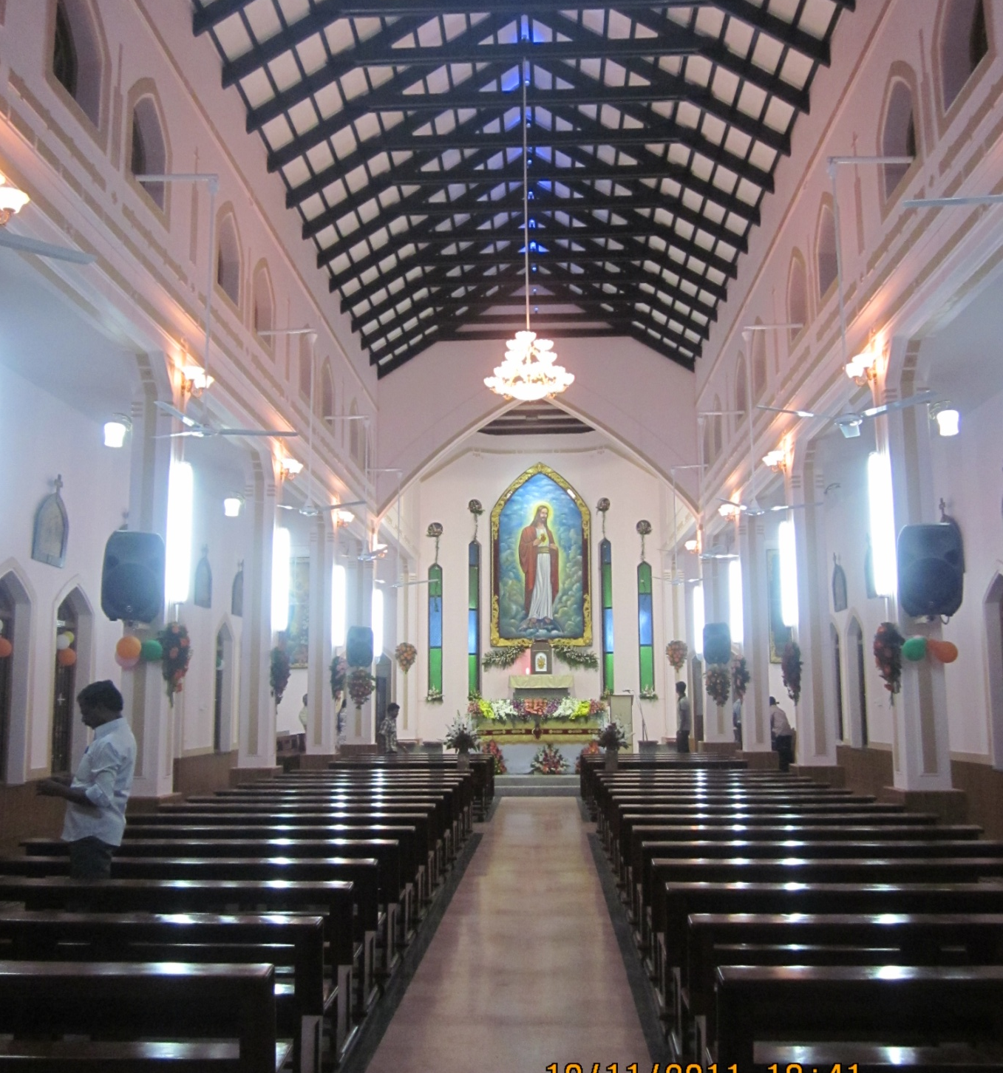
SACRED HEART COLLEGE
Wharfadale Speaker System Installed
Product Used
Wharfadale Titan15 2-way Speaker
Studiomaster PA 2.0 Power Amp
Studiomaster Diapro16.3 16ch Mixer Board
Shure SM58 Microphone, Ahuja SHM1000XLR, AUD101XLR Microphones
A

Slide 3
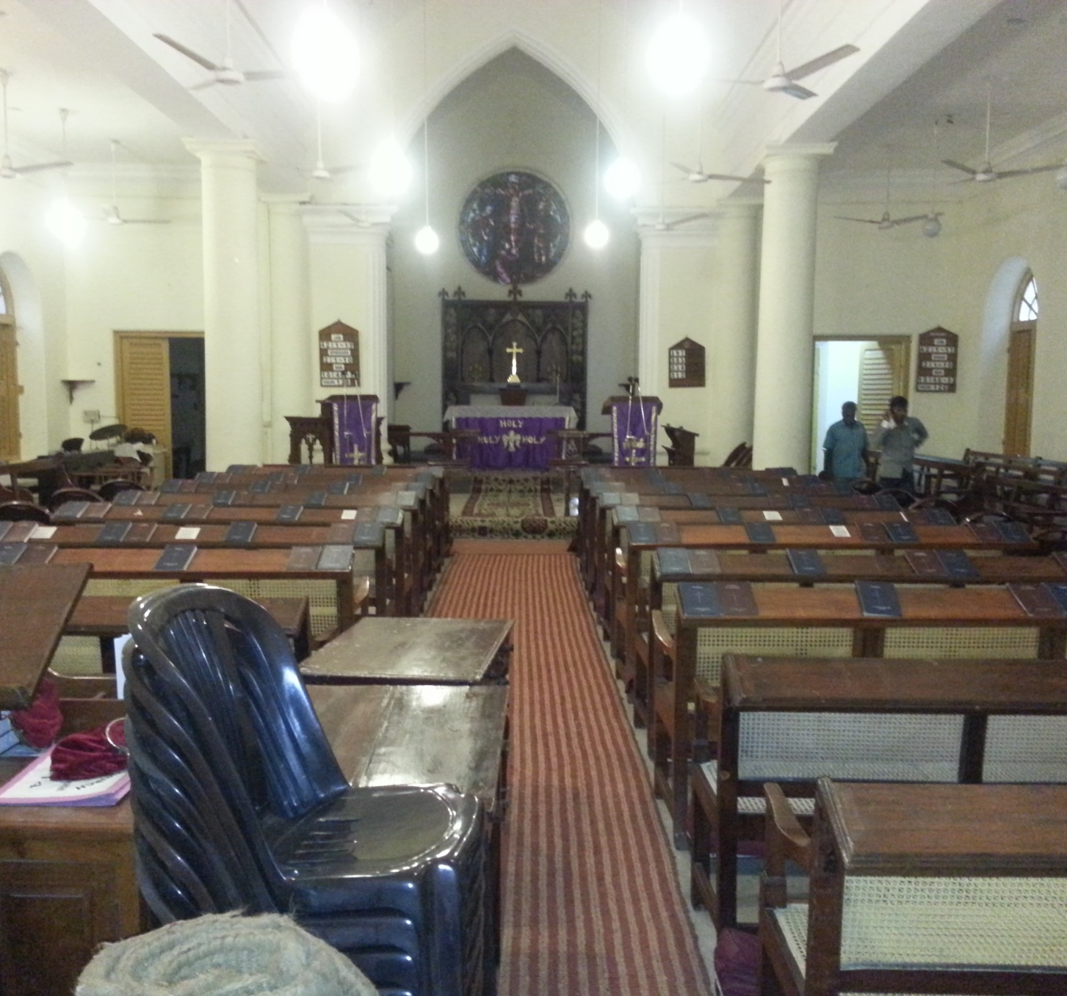
ST JOHNS CHURCH
JBL Speaker System Installed
Product Used
JBL JRX215 2-way Speaker System
Crown XLI Series Power Amplifiers
AllenHeath 16Ch Mixer Board
Shure Microphones

Slide 4
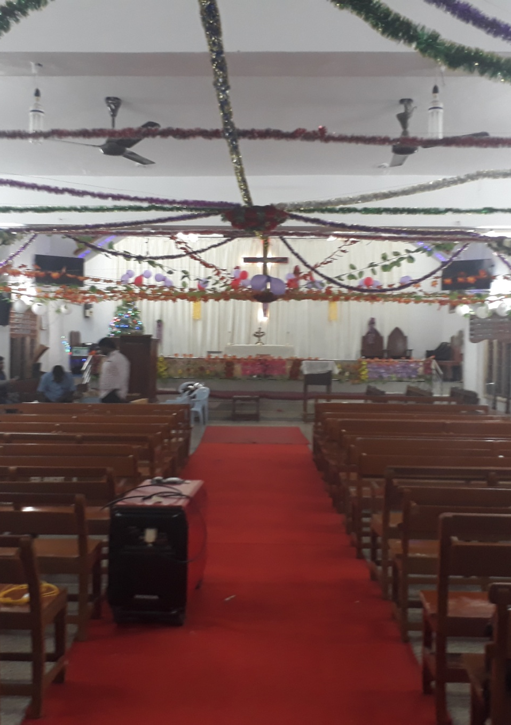
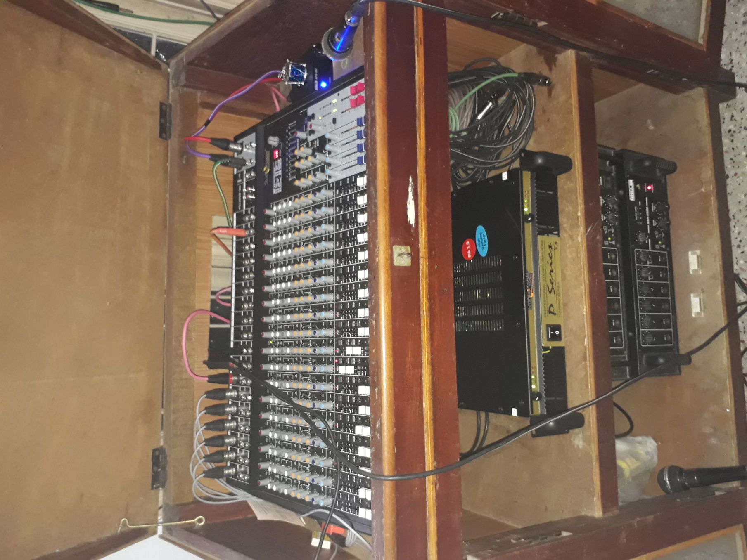
CSI SCUDDER CHURCH
Studiomaster Speaker System Installed
Product Used
Studiomaster EKS 151 2-way Speaker
Studiomaster PA2.0 Power Amp
Studiomaster 18ch Mixer Board
Shure SM58, MX418C Microphones
AHUJA SHM1000XLR, AUD101XLR Microphones

Slide 5
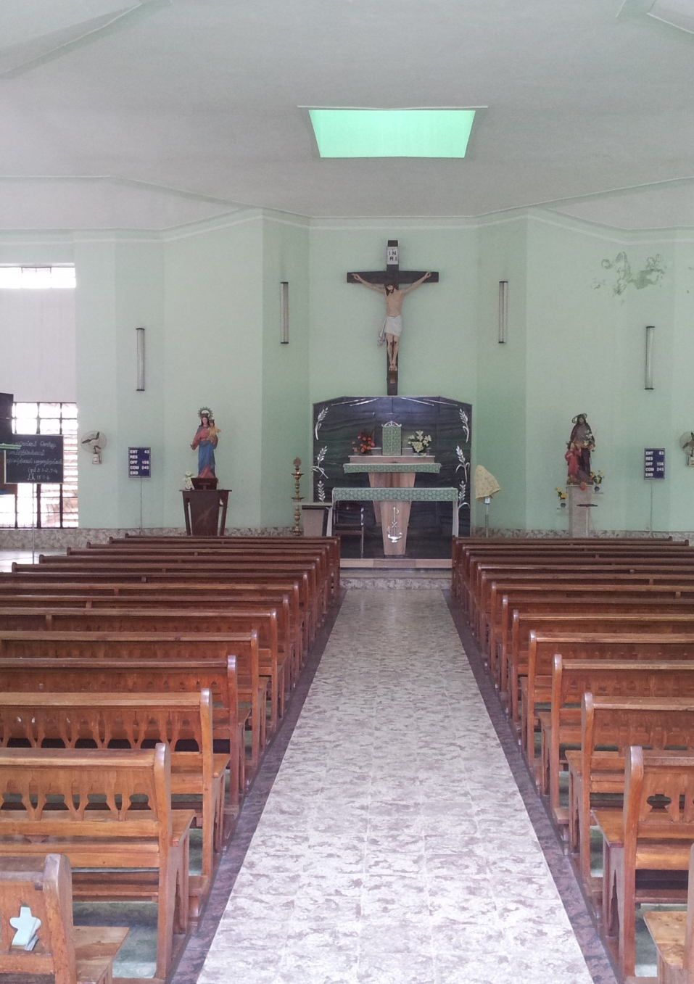
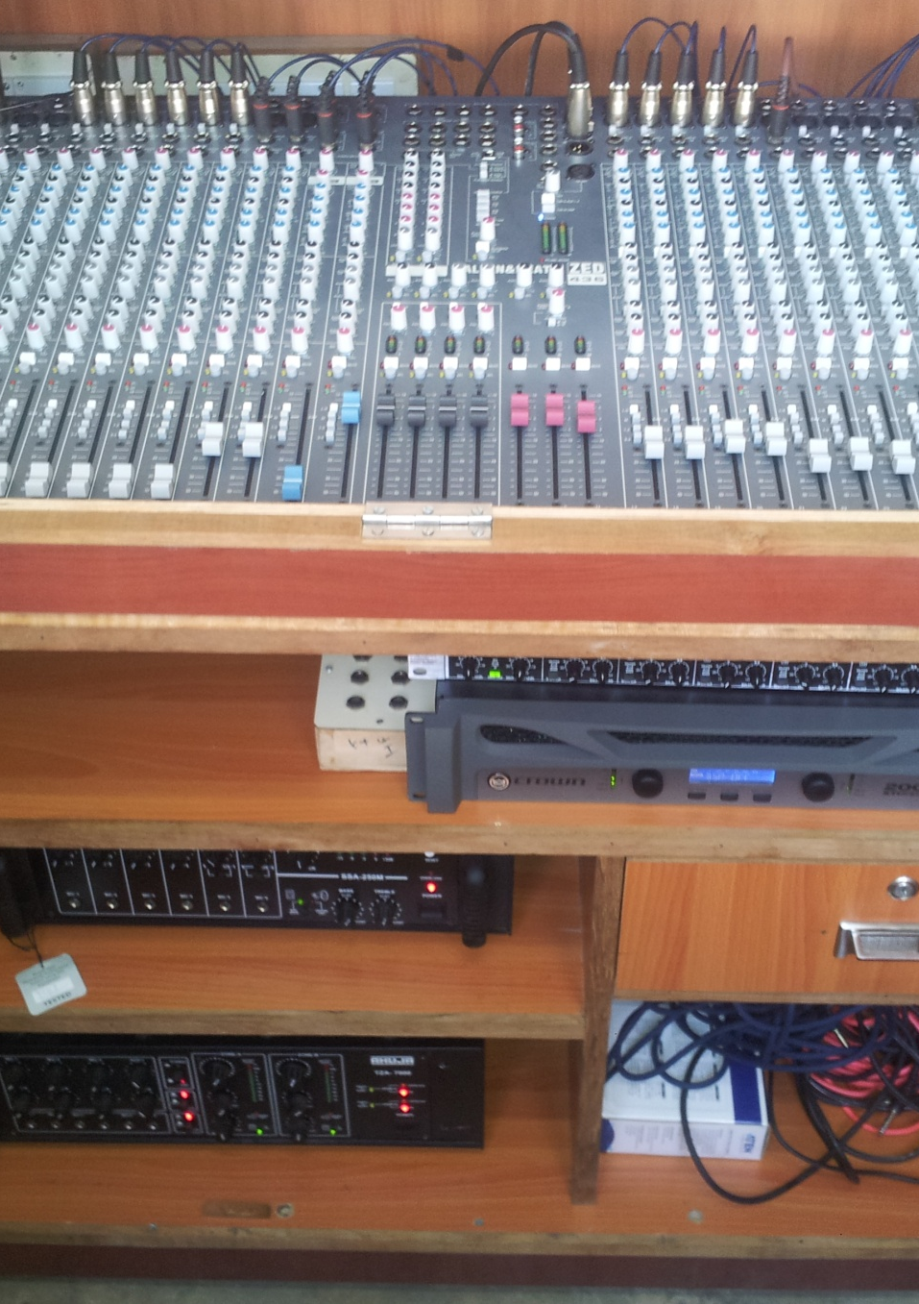
AUXILLIUM CHURCH
JBL Speaker System Installed
Product Used
Crown JRX 215 2-Way Speaker System
Crown XLI series Power Amp
AllenHeath 32ch MixerBoard
Shure Microphones

Slide 6
THANK YOU

