Slide 1

CONFERENCE
AND
BOARDROOM
INSTALLATIONS

Slide 2
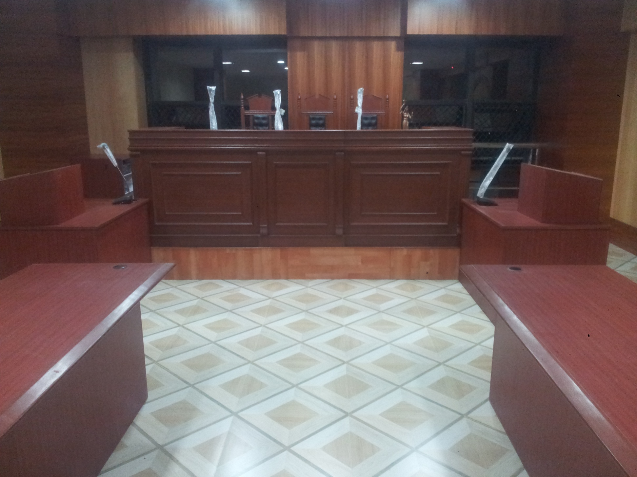
VIT
LAW COLLEGE
Ahuja Conference System Installed
Customer requirement
The client wanted a Audio Visual solution for a mockup court room.
A conference room was proposed which has a chairman unit and 2 delegate unit.The chairman unit can control the delegate unit.On the Video solution part all the court proceedings can be captured through cameras and viewed by a 40”LED TV which is outside the court room.
Product Used
Ahuja Conference System with Cahirman n Delegate Unit.
Ceiling Speakers and Amlifiers
SAMSUNG 40” LED panel
HONEYWELL 3mp IP Bullet camera

Slide 3
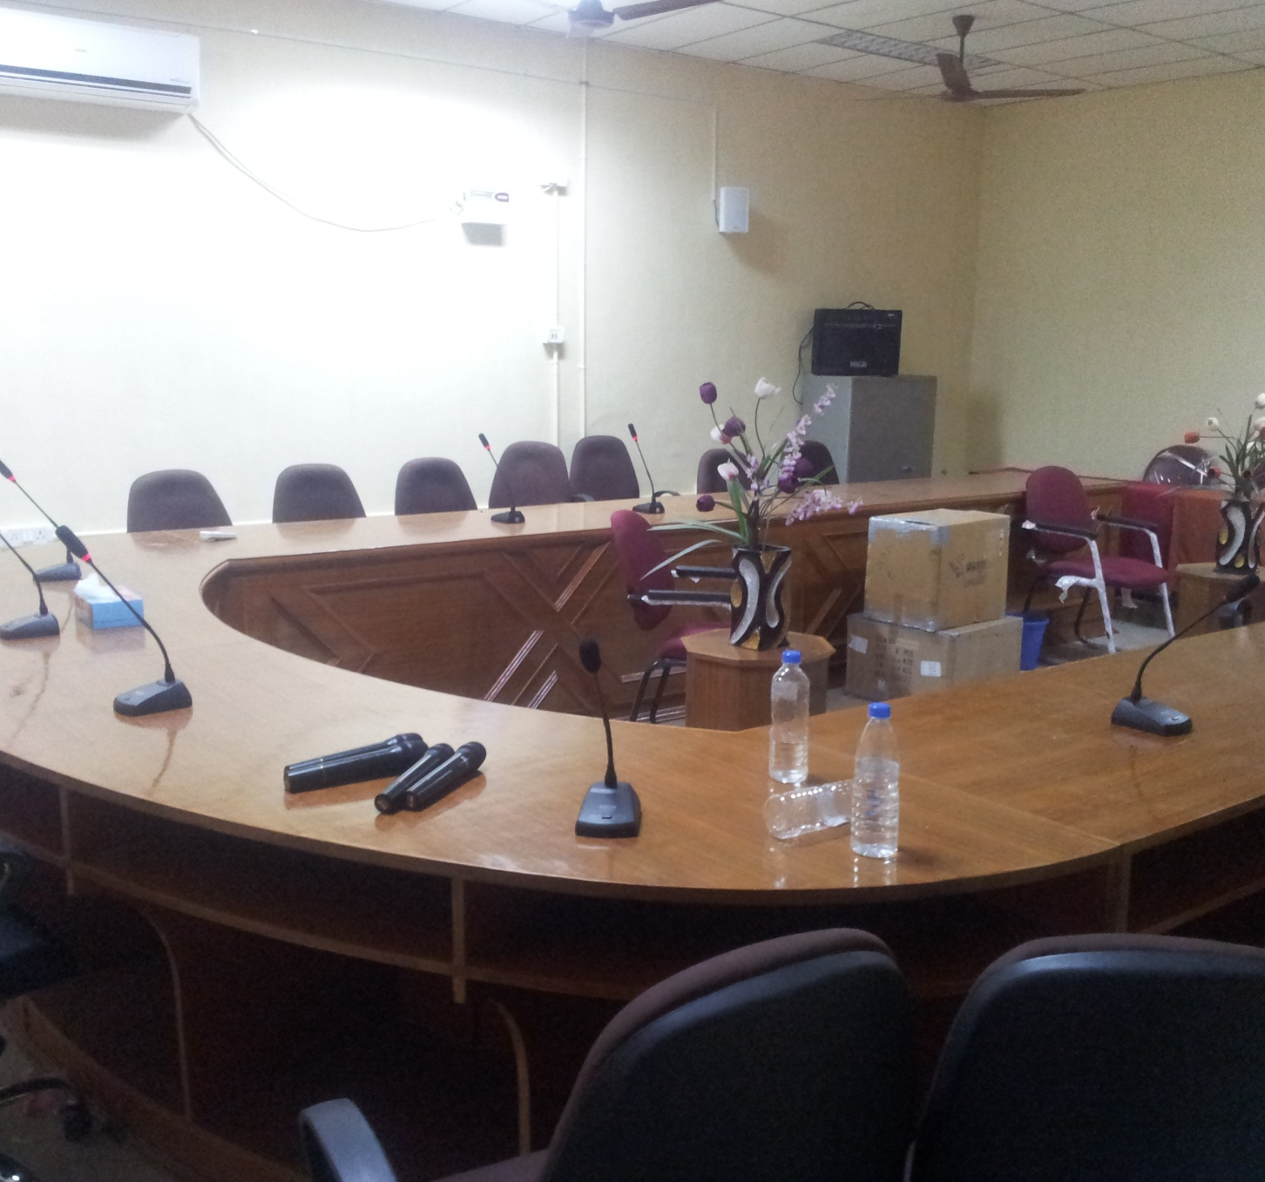
ABDUL HAKEEM COLLEGE
Ahuja Wireless Conference System
Product used
AHUJA AWM400V Wireless Conference System
AHUJA DPR125 USB Recording Amplifier
AHUJA PS500T 2 way Wall Speaker

Slide 4
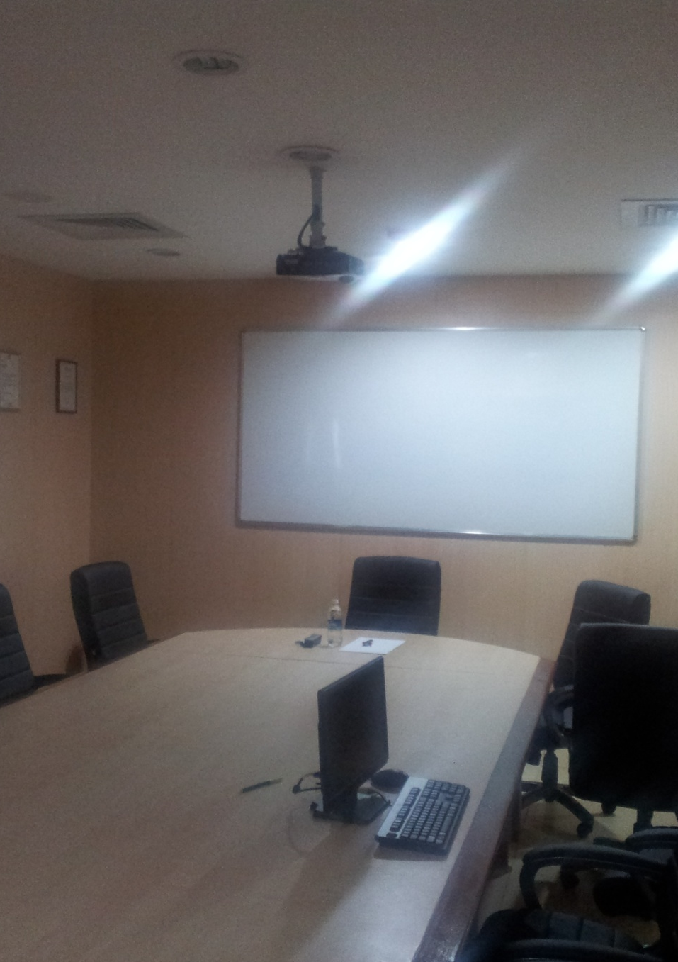
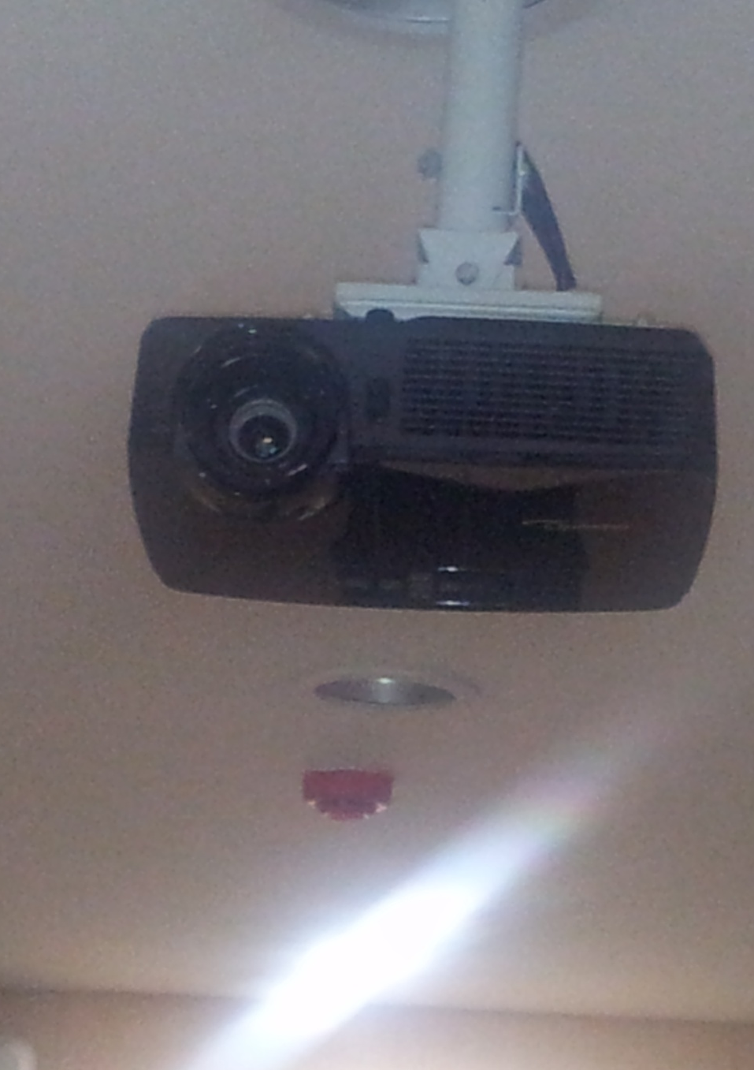
CMC
DISTANCE EDUCATION DEPARTMENT
Installation of projector in a Board Room

Slide 5
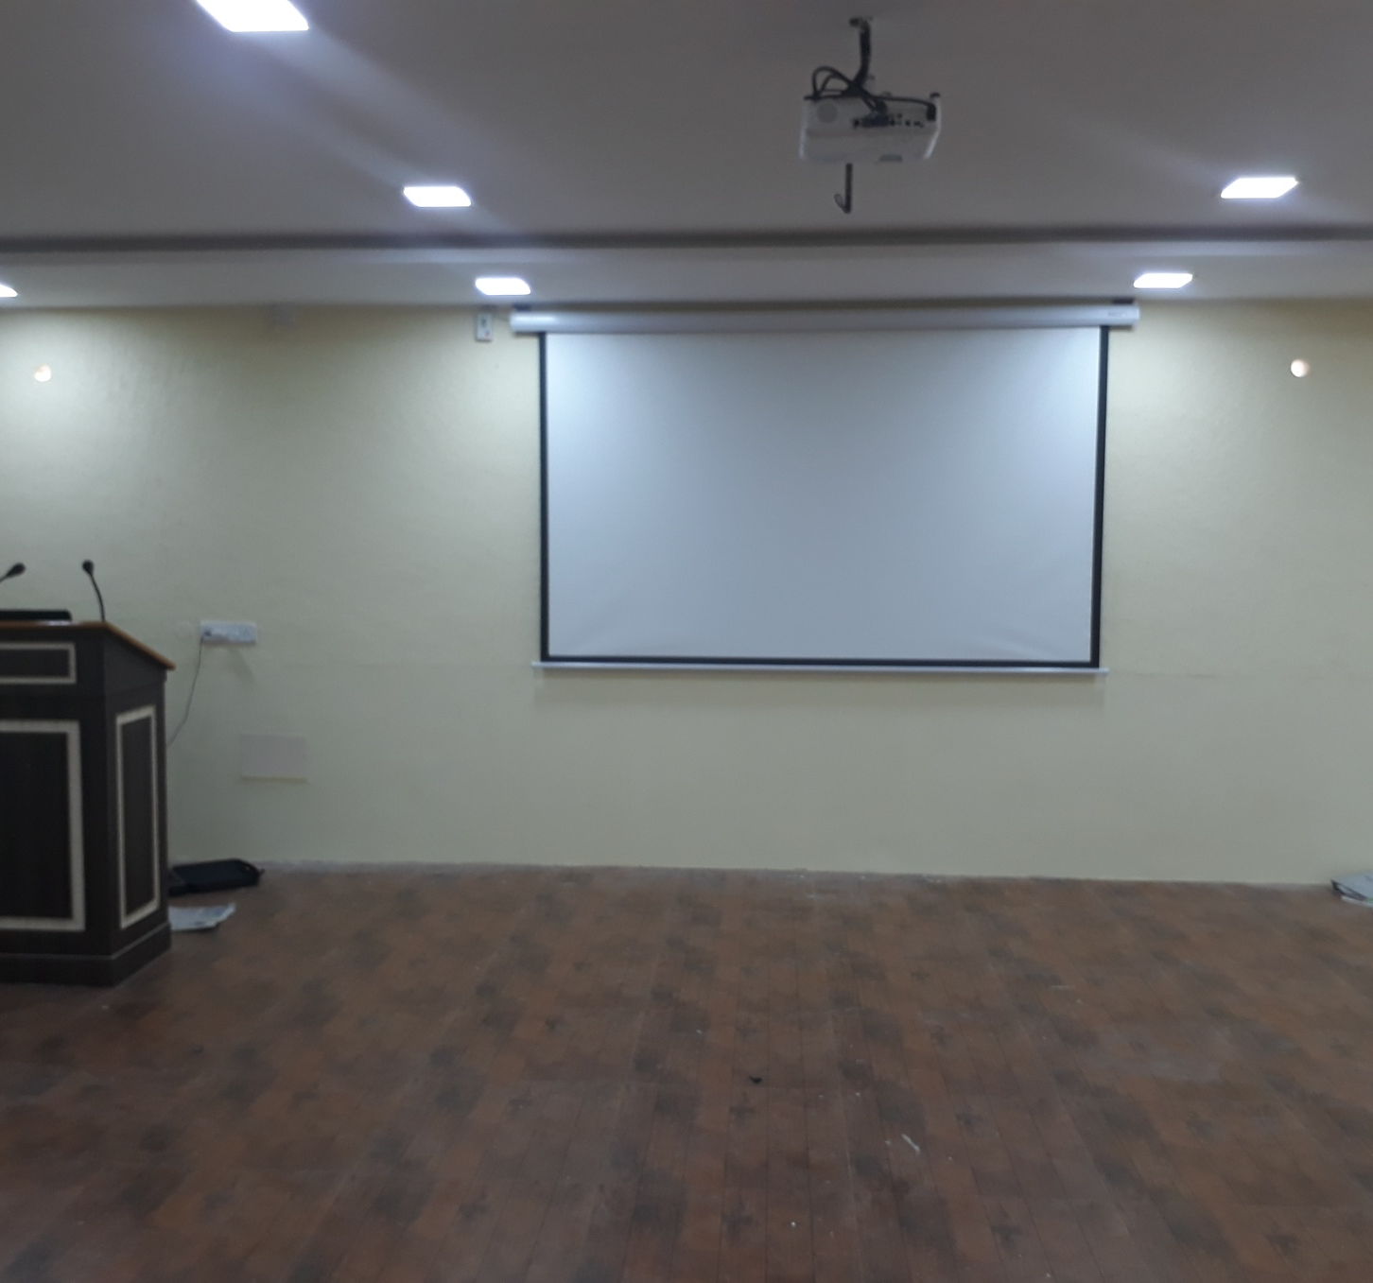
SEVENTHDAY ADVENTIST
CONFERENCE ROOM
Audio Video Solution was implemented for a Conference Hall
Products Used
AHUJA SMX602T 2 Way Wall Speaker
AHUJA TZA2000 2 Zone USB Amplifier
AHUJA AGN480 GooseNeck Podium Microphone
Studiomaster BR48 Dual Hand Held Wireless Microphone
Epson EB-X36 LCD Projector
Liberty 6x8 MW Wall Mount Motorised Projector Screen
The Podium has an Interactive Display Panel which is connected to the Projector

Slide 6
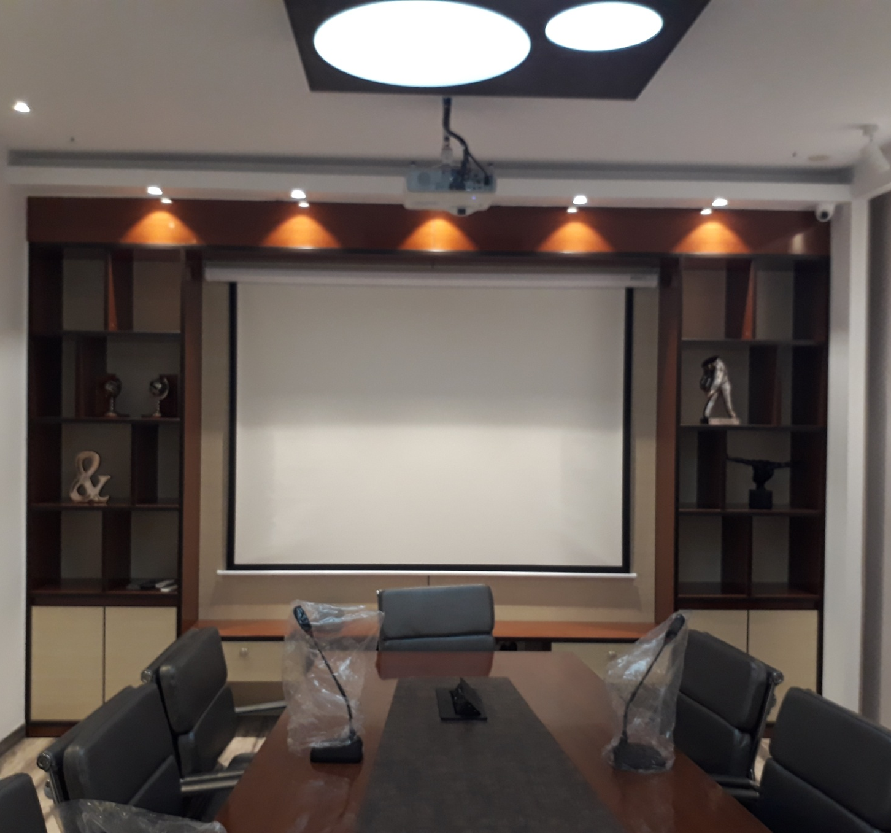
VALLI EXPORTS CHENNAI
BOARD ROOM
Audio Video Solution was implemented for a Board Room.
Provided a Wireless Conference System for the Board Room with Amplifier and Speaker
Epson EB535W Short Throw Projector and Liberty 5x7 Motorised Projector Screen was Installed
Projector is connected to the cable cuby flush mounted on the Conference table .

Slide 7
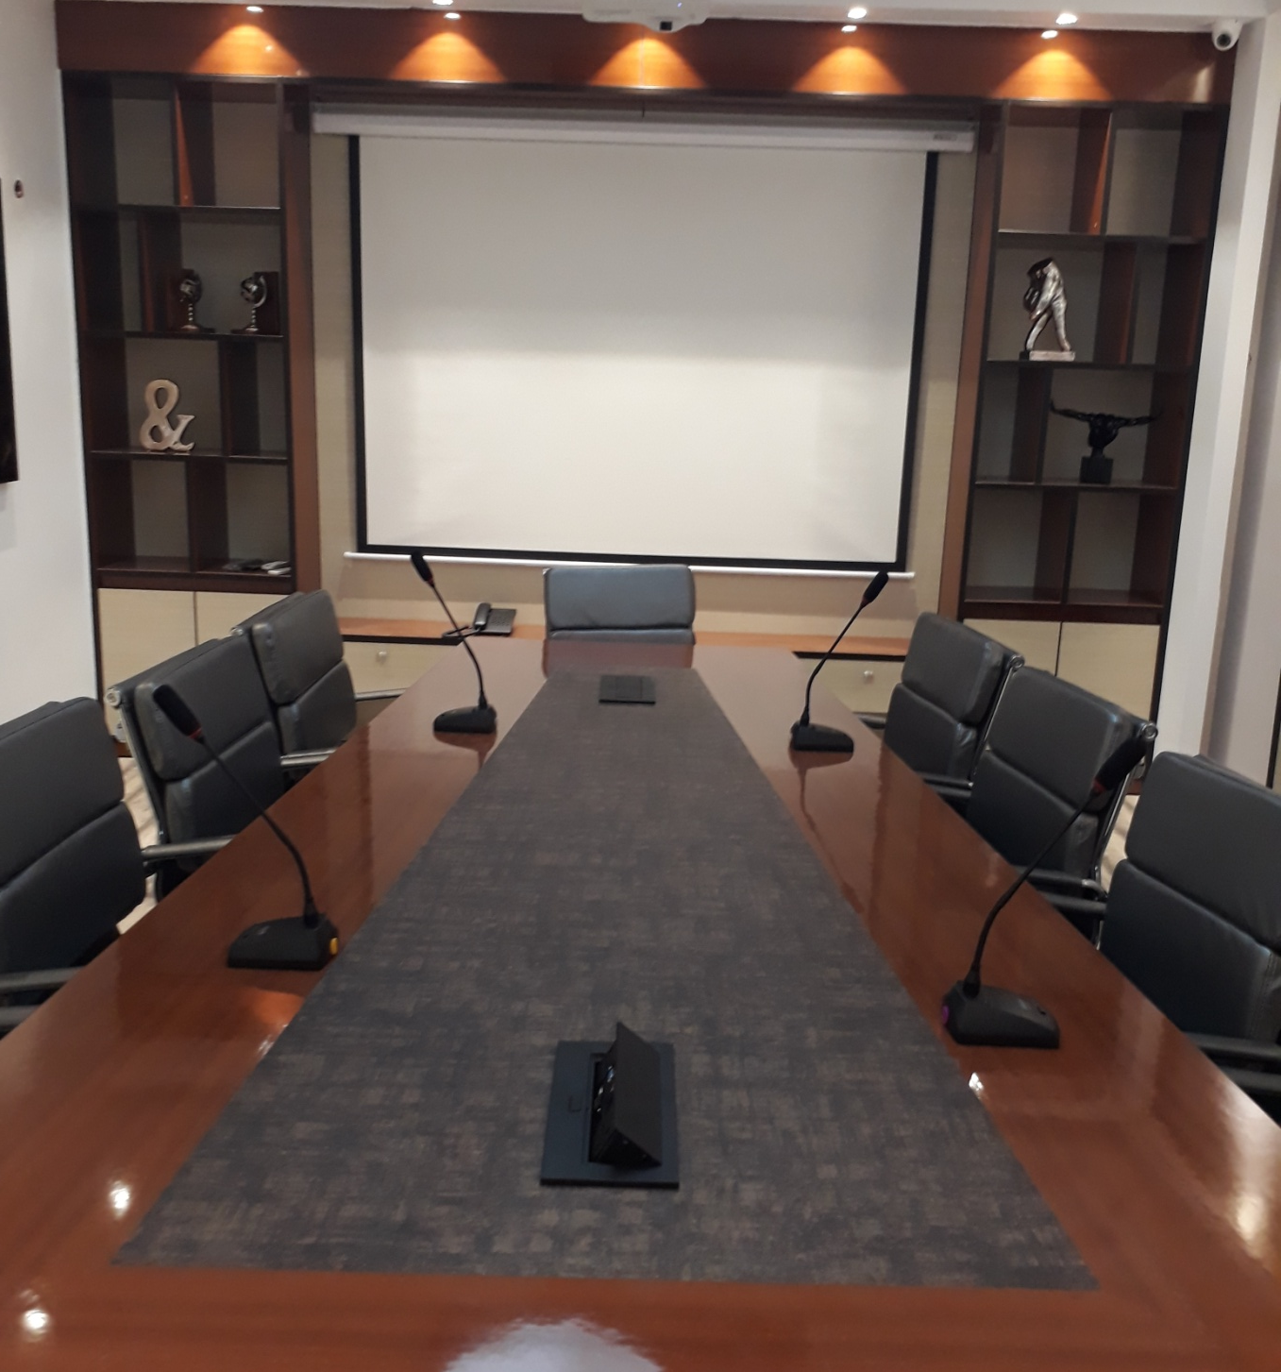
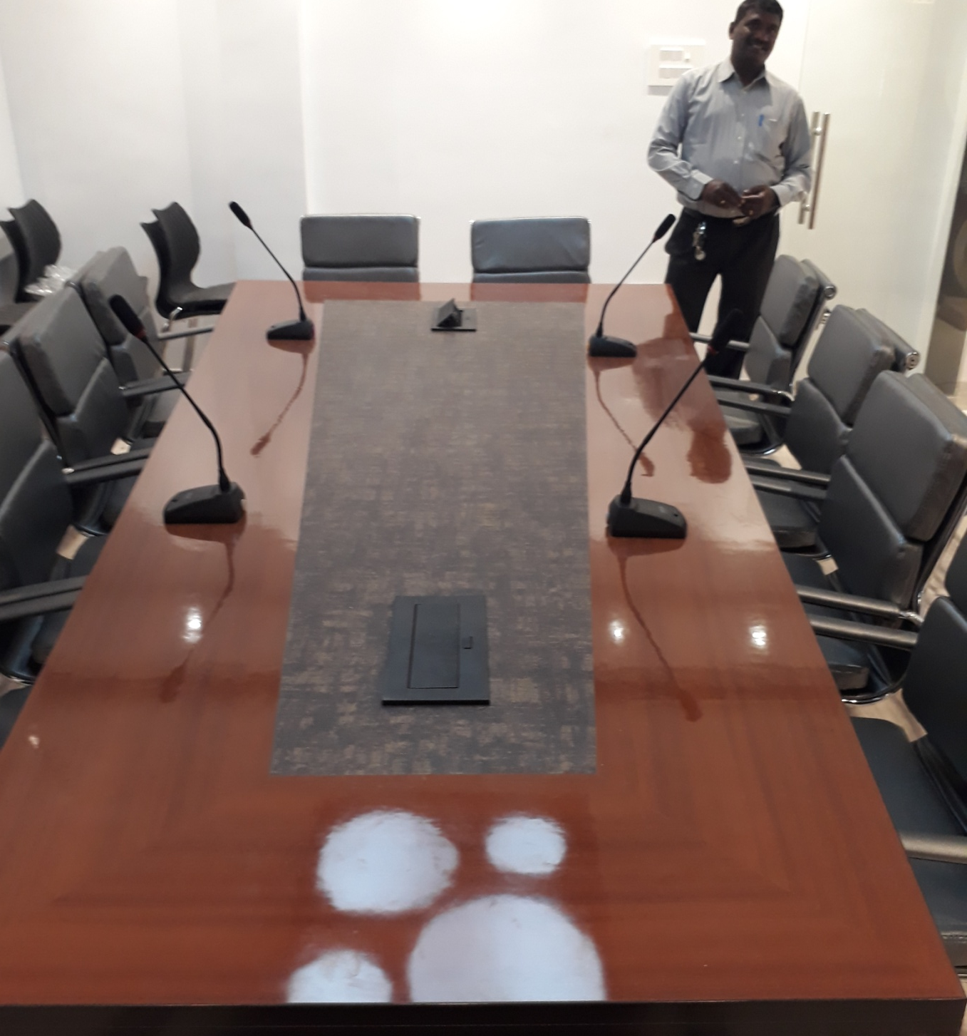

Slide 8
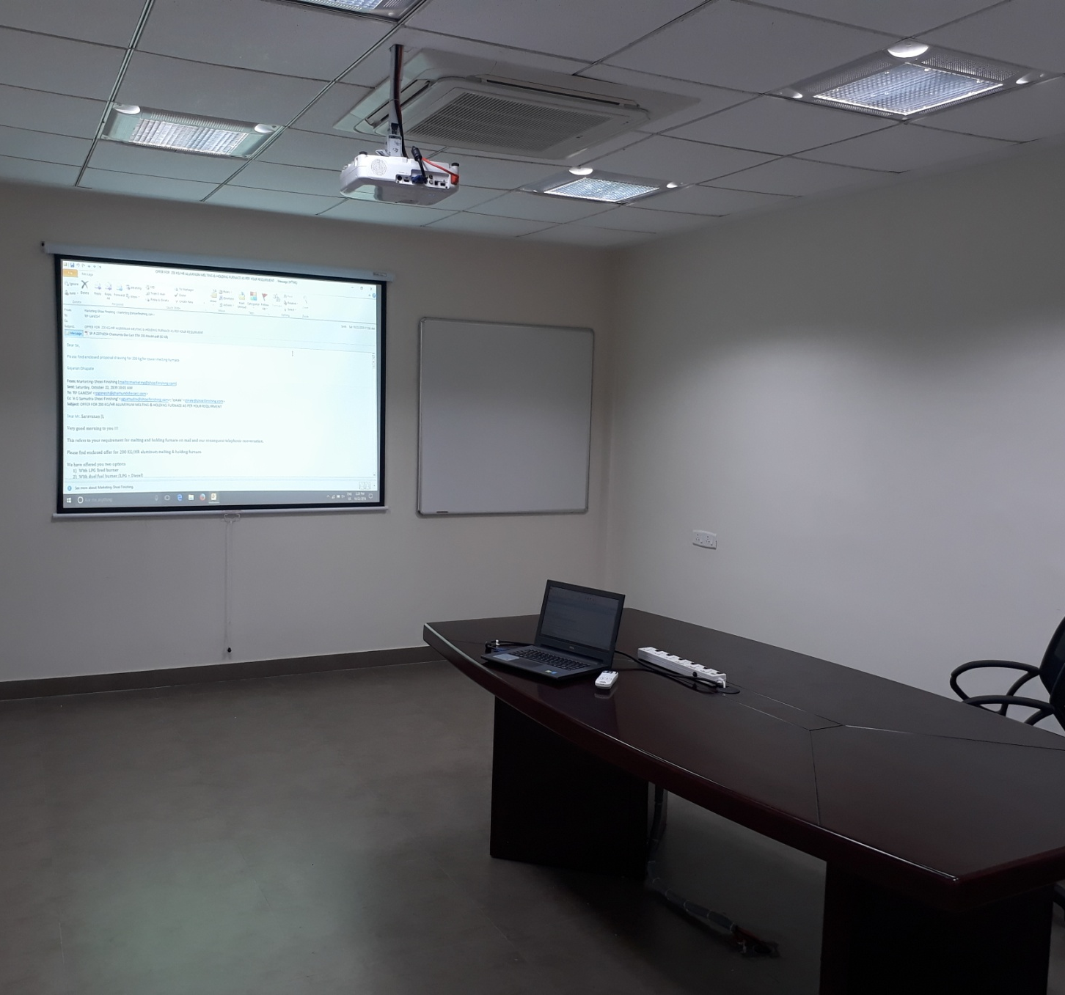
CHAMUNDI DYE CAST
Installation of Projector and Screen in a BoardRoom
Product Used
EPSON EB X31 LCD Projector
Liberty 5x7 Wall Mount Projector Screen

Slide 9
THANK YOU

