Slide 1

HOME THEATRE
INSTALLATION

Slide 2
Home theatre systems can offer more fun and functionality when watching movies than a stereo hi-fi system, you'll be enjoying your music and movies in no time.

Slide 3
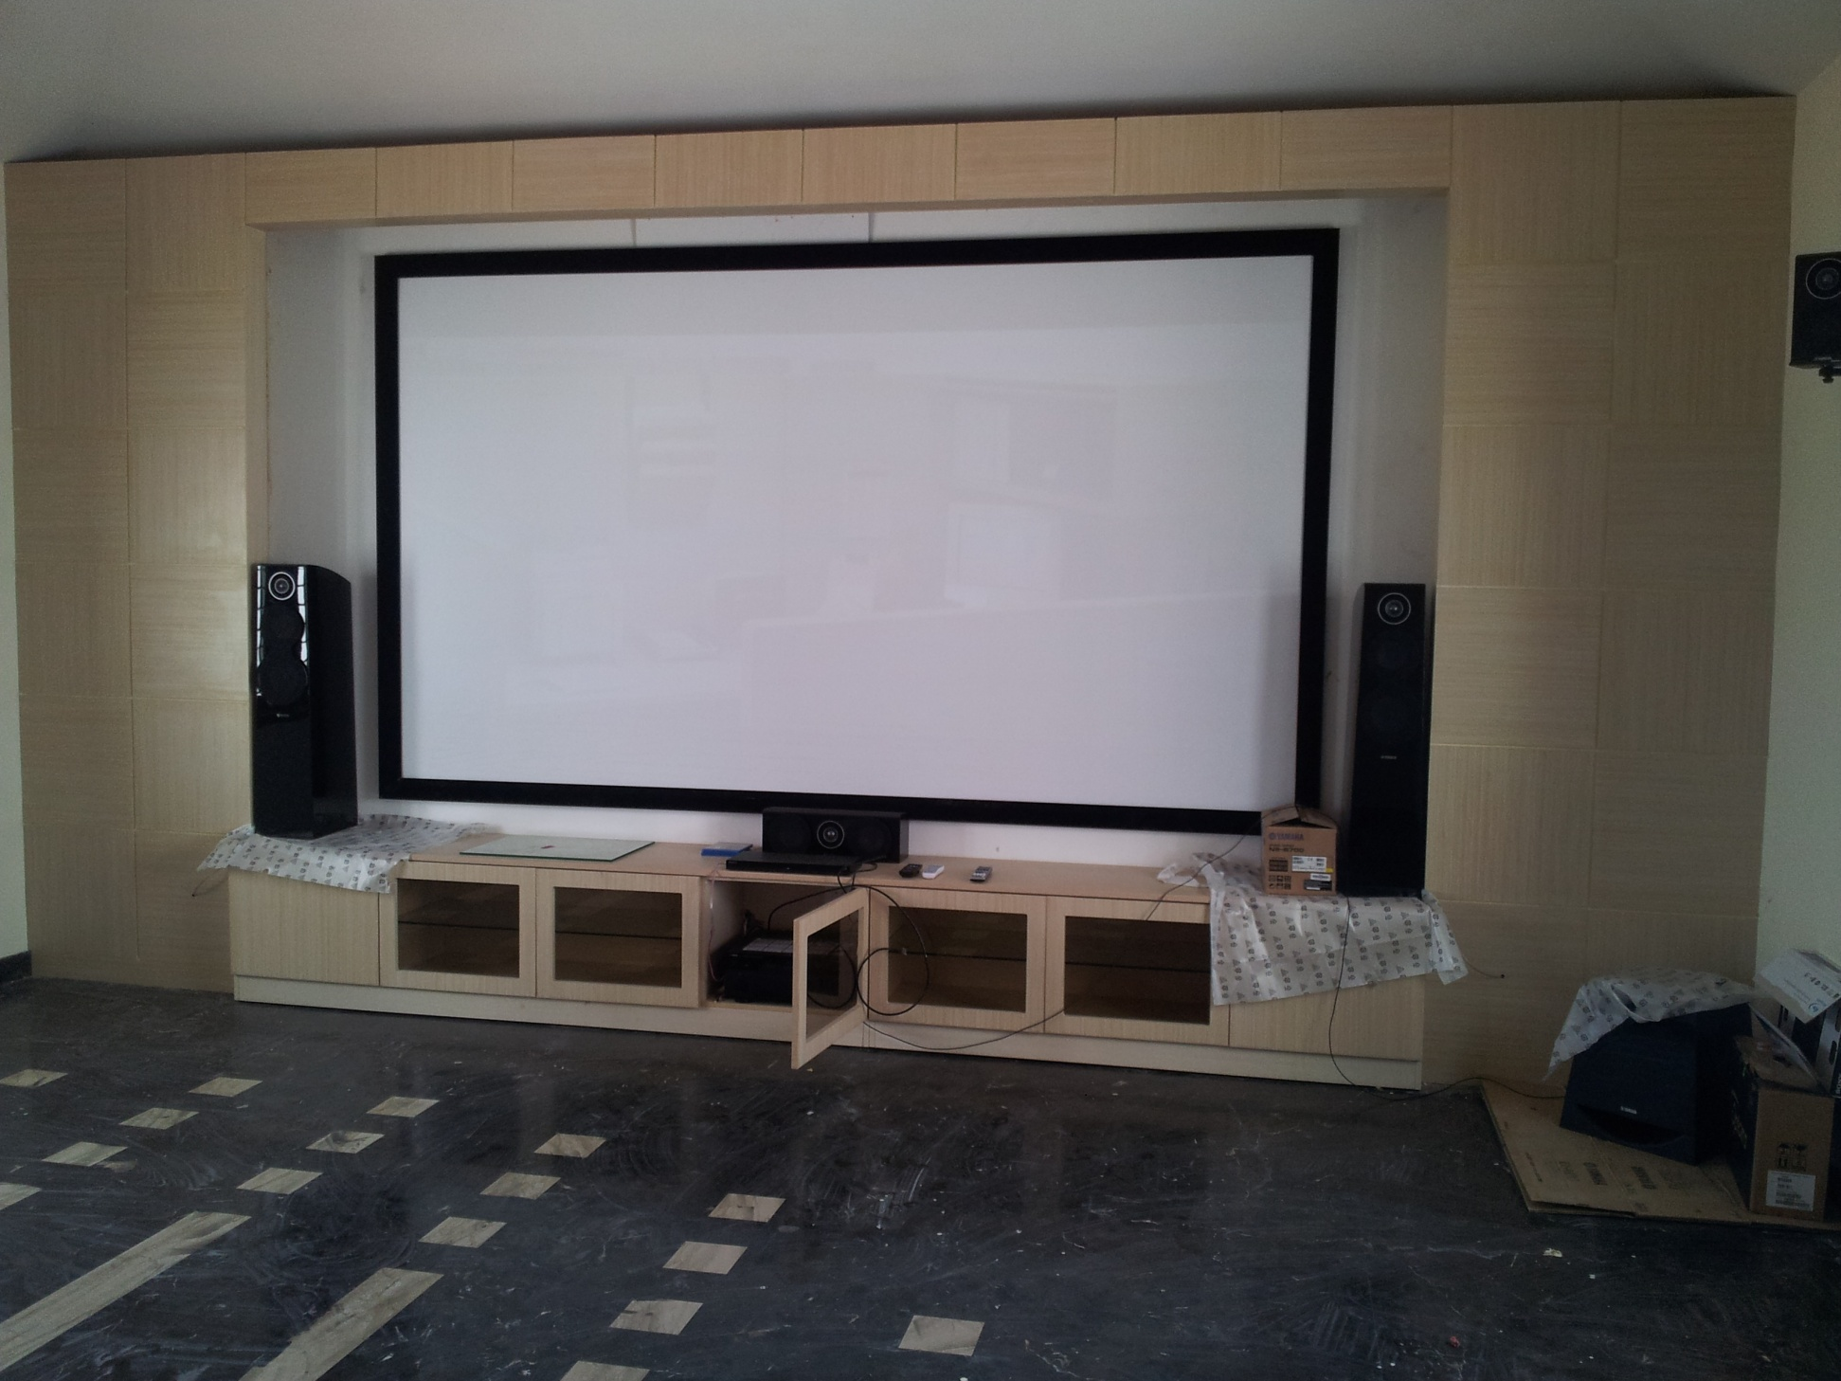
Home Theatre Installation was executed to one our client.
Product Used
Epson EBTW5300 Home Theatre Projector
Elite 150”Diagonal Fixed Frame Home Theatre Projector Screen
Yamaha7.1 Professional Home theatre system with RXV679 AV Receiver/NSF500 3way Tower Speaker System/SubWoofer/NSP500 Book Shelf Speakers

Slide 4
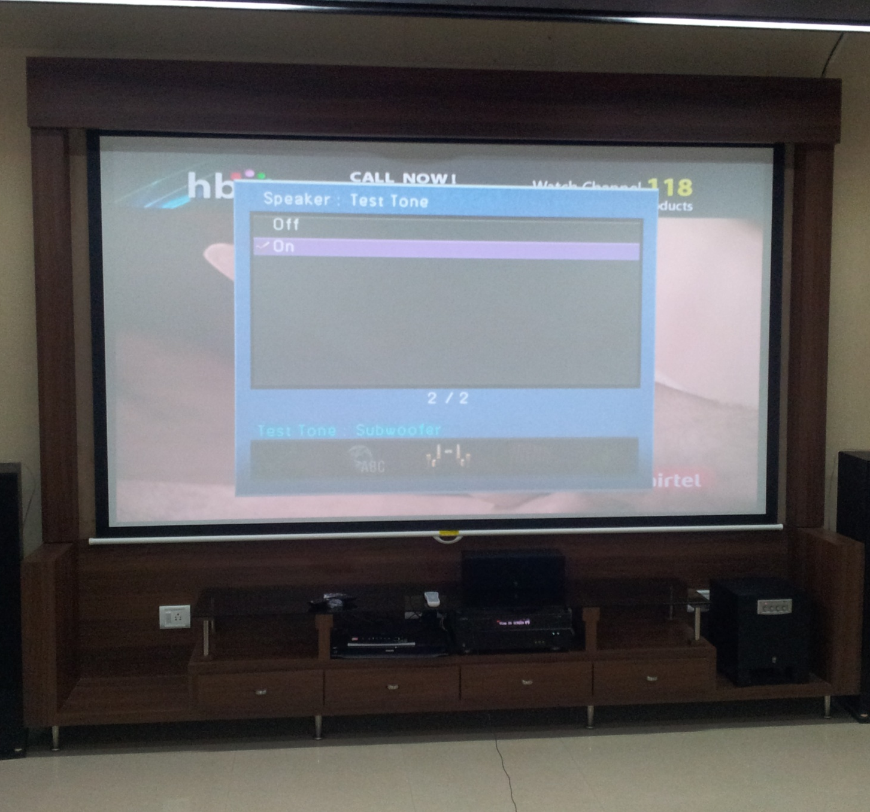
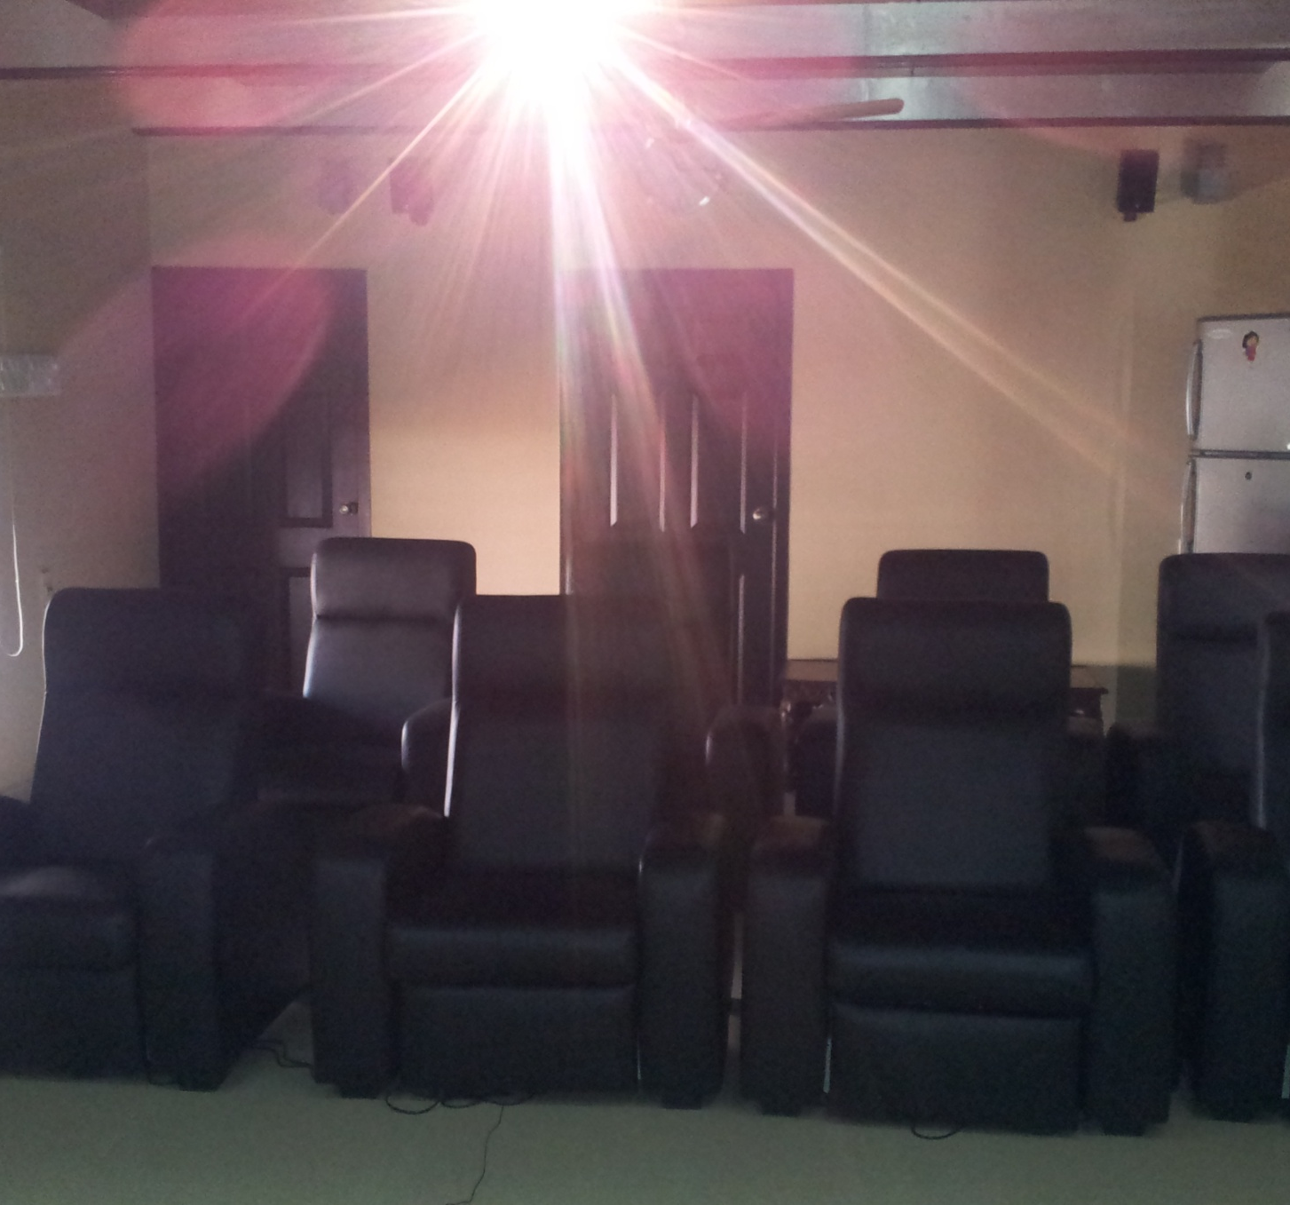

Slide 5

Product used
Optoma Home Theatre Projector
120” Diagonal 16:9 Projector Screen
Yamaha 5.1ch Home theatre System

Slide 6
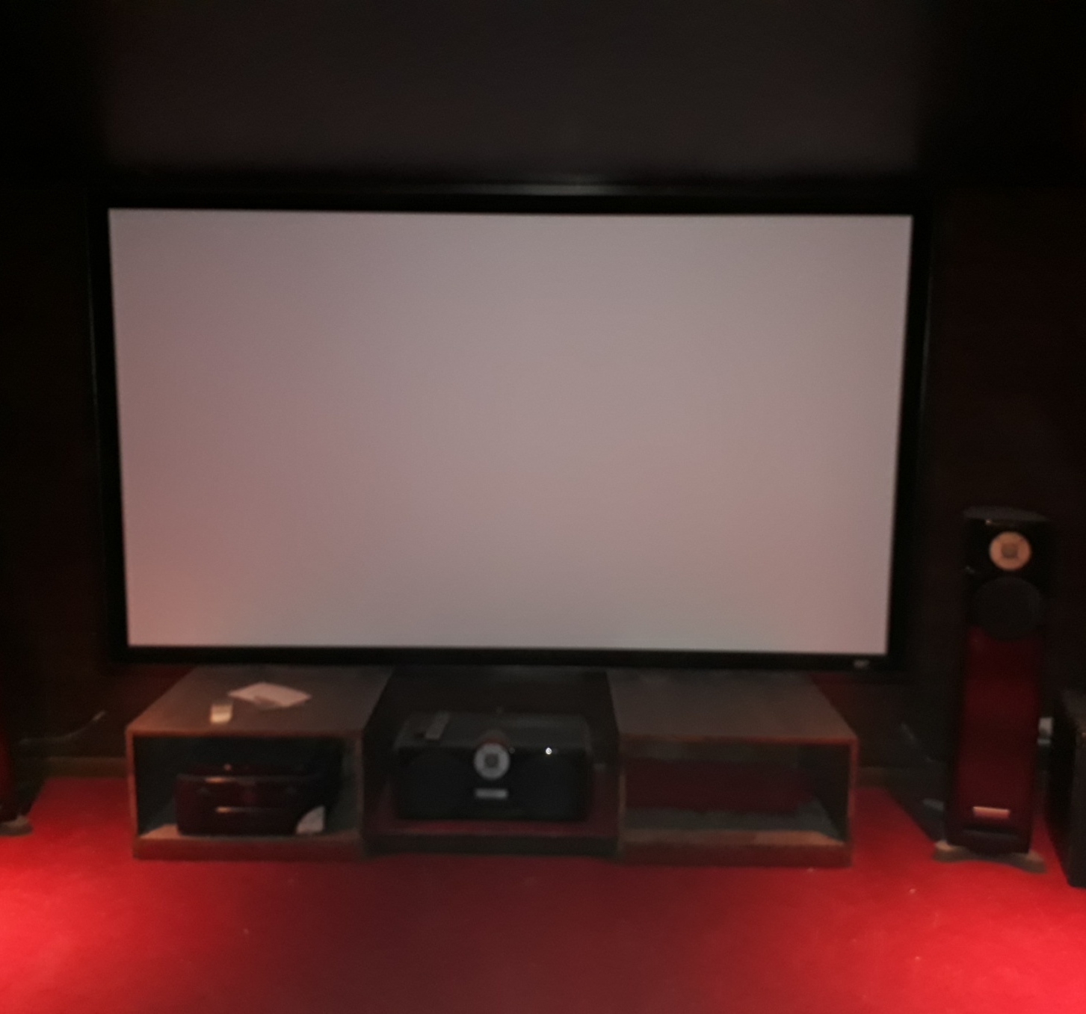
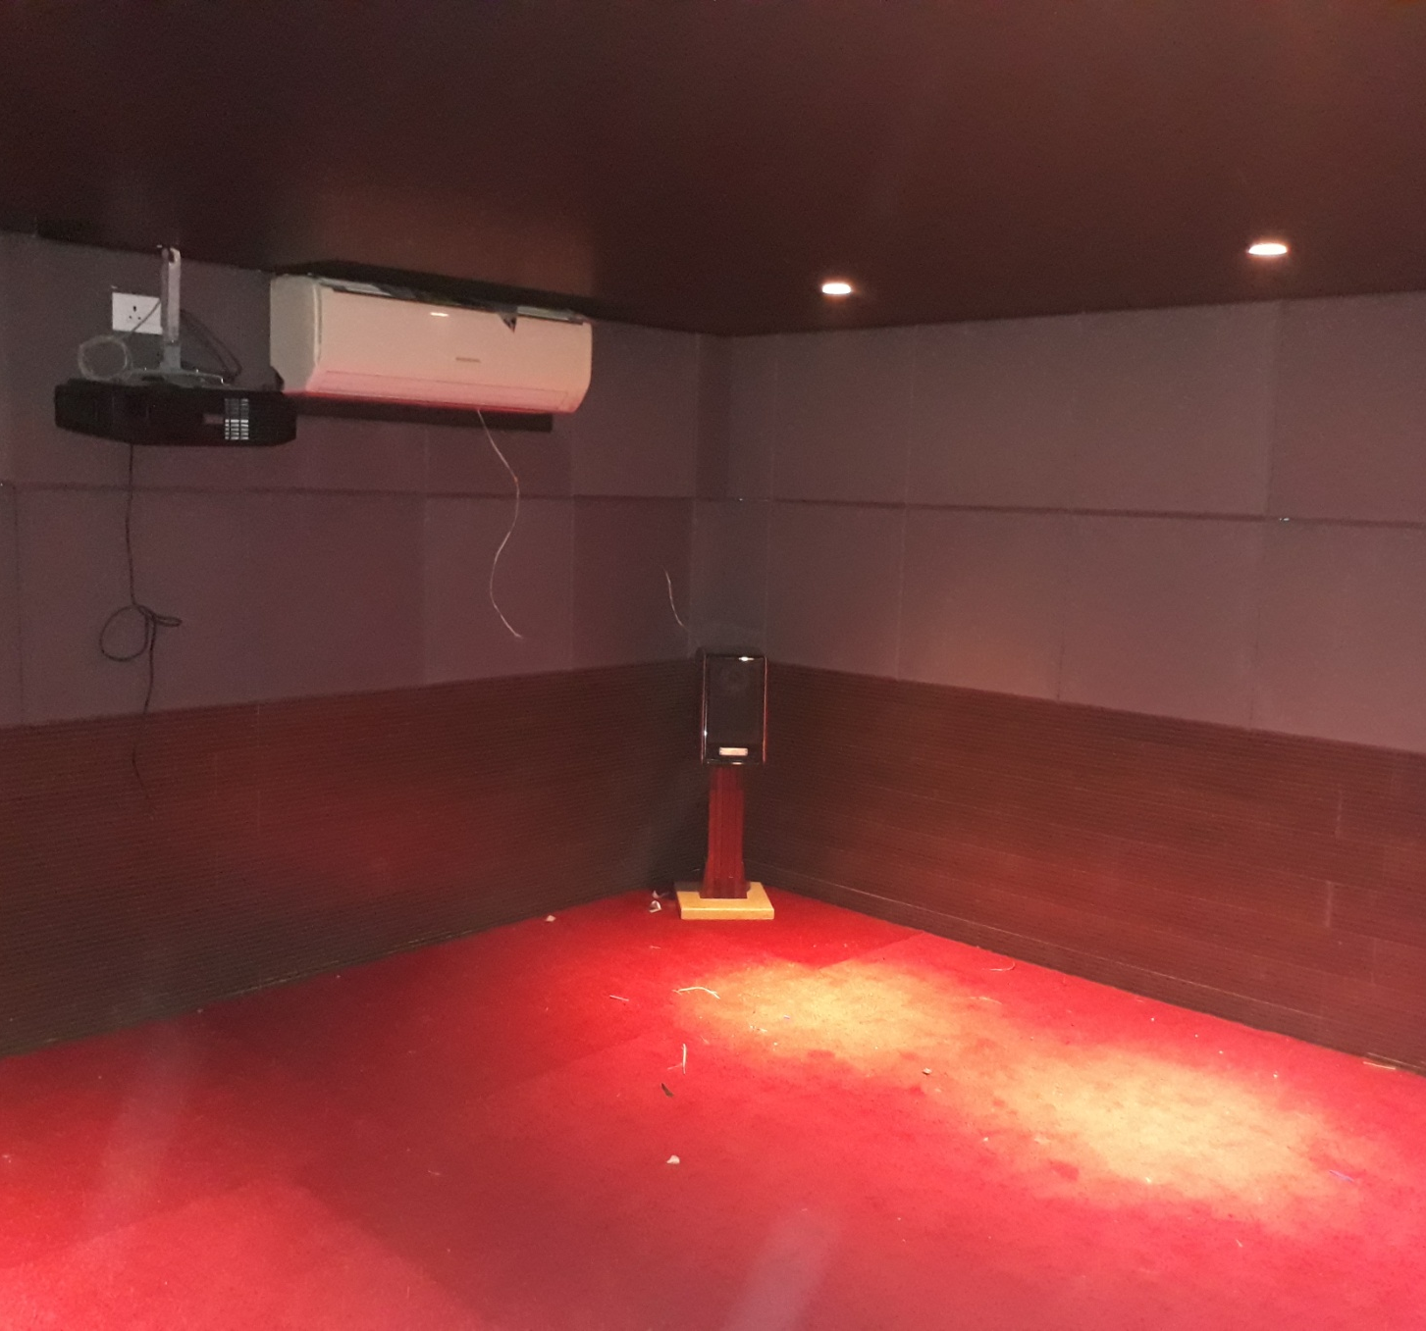

Slide 7
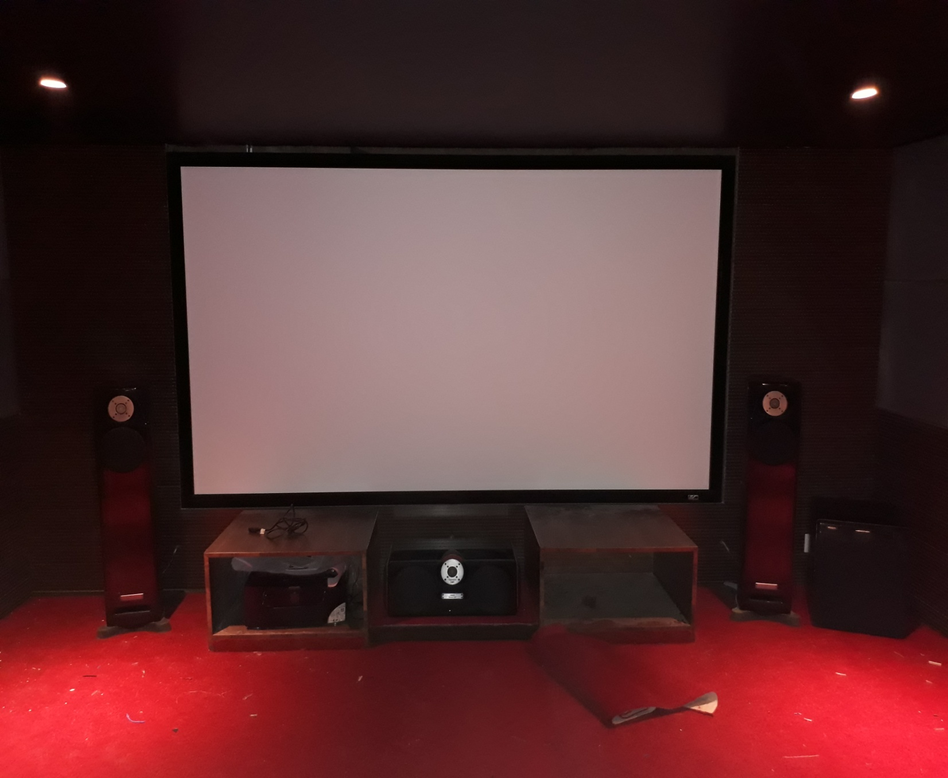
A complete solution for Home theatre room by installing acoustic fabric and wooden panels on the walls.
Implemented AV solution by providing Marantz 5.1 ch AV receiver and speaker system
Panasonic projector and Elite 120” fixed frame Home Theatre Projector Screen was installed.

Slide 8
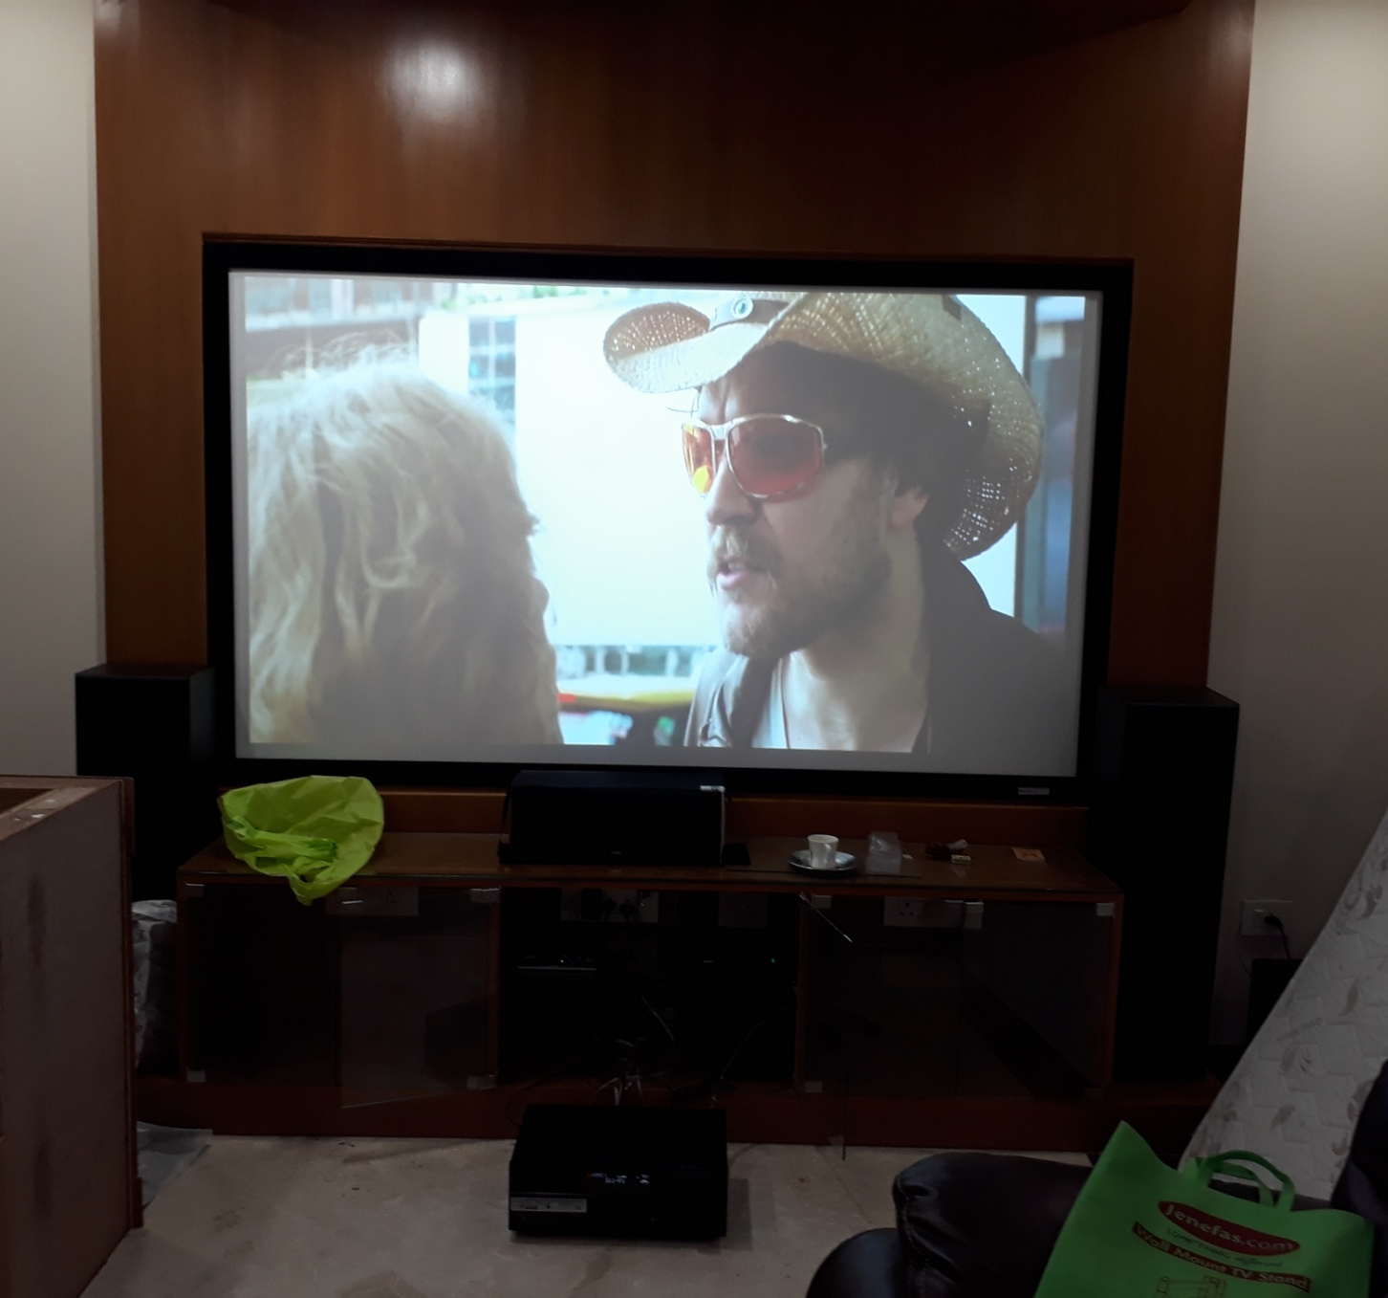
Product Used
Yamaha 5.1 ch Home Theatre system
EPSON EB TW5300 HT Projector
Liberty 97” Diagnol HT Projector screen

Slide 9
THANK YOU

