Slide 1

SMART CLASS ROOM

Slide 2
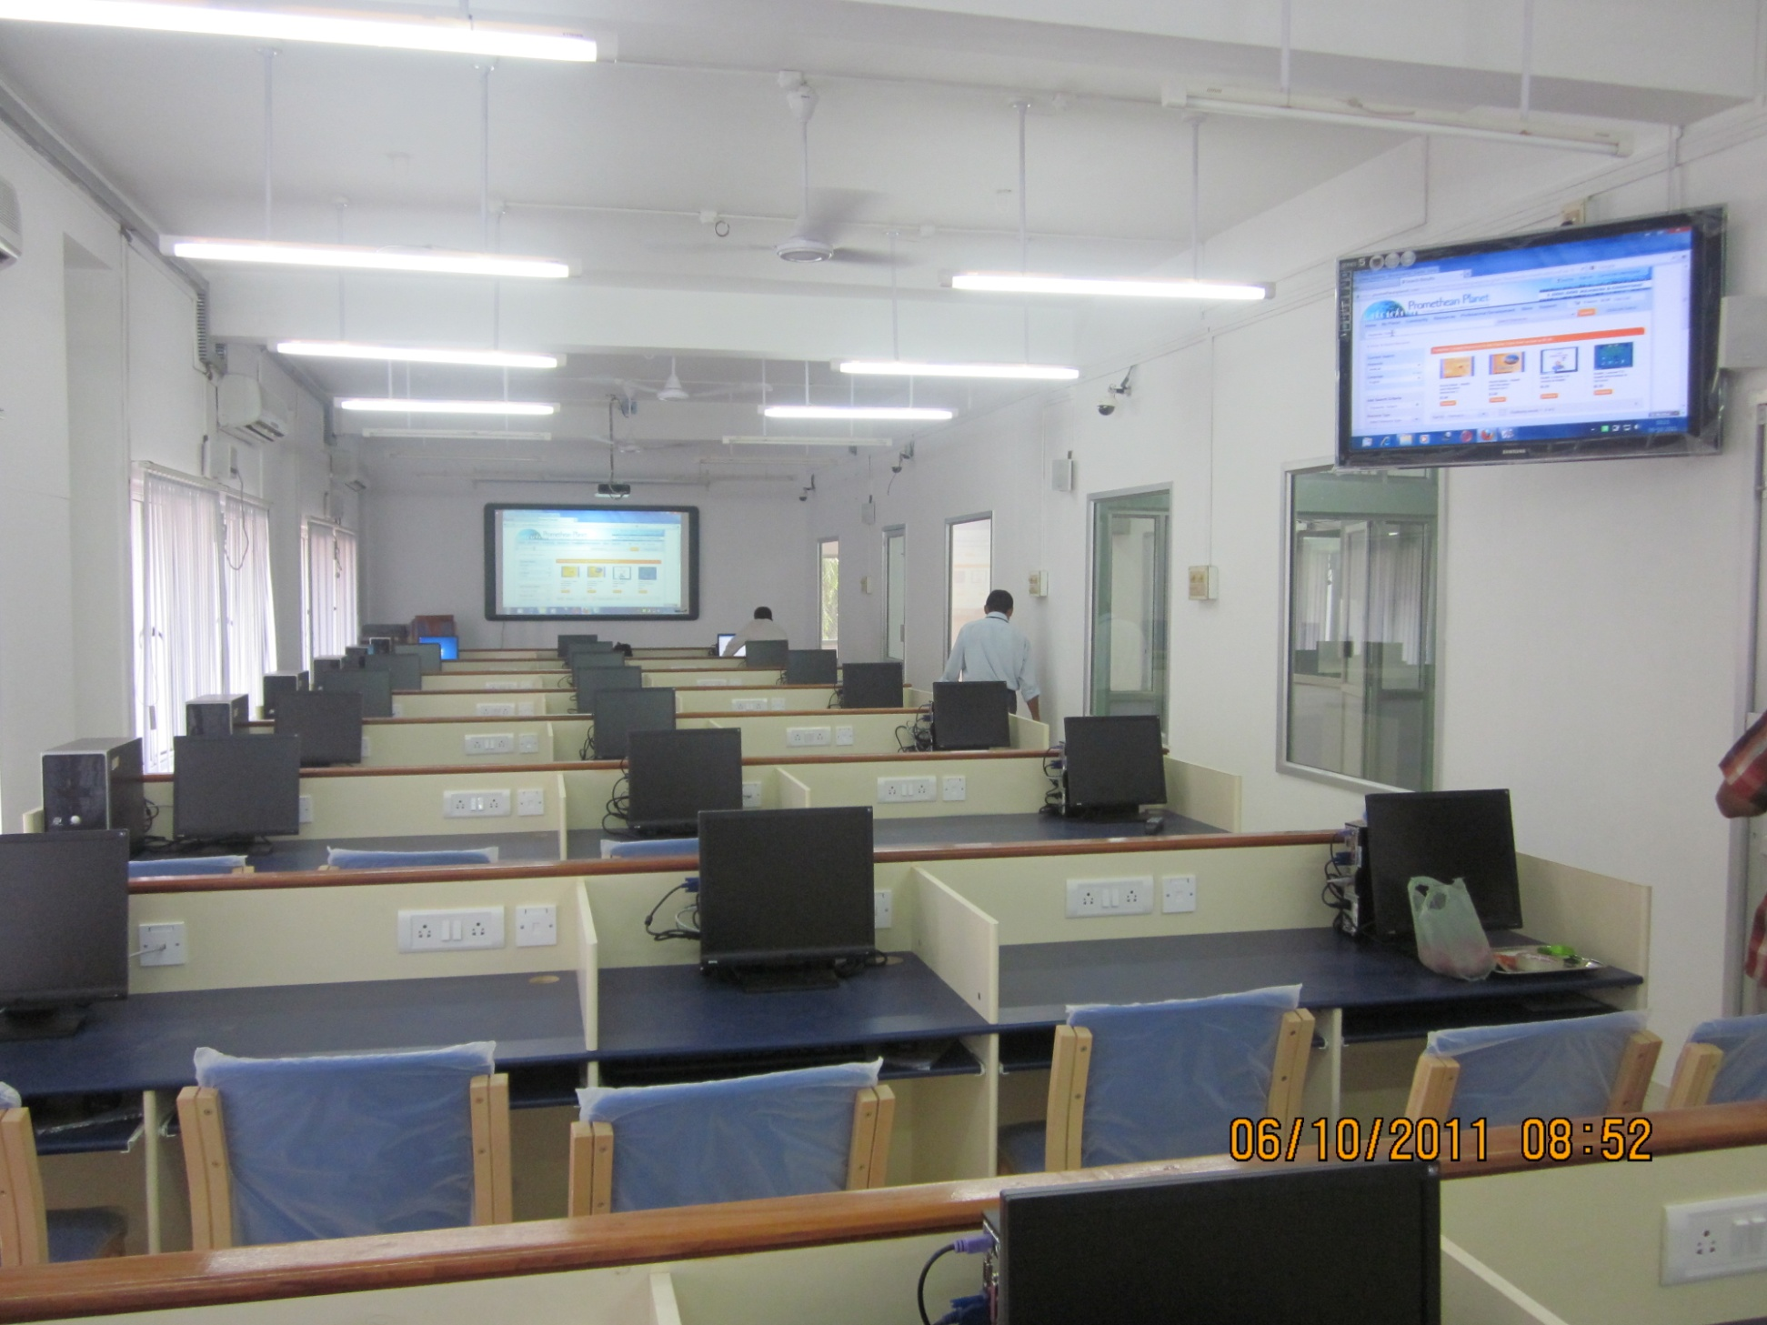
CHRISTIAN MEDICAL COLLEGE
(CMC)
This Smart class room installation was implemented for CMC e-learning department.
Promethean 95” Interactive White Board was connected to all the PCs through network using LAN school software .
The communication features found in LanSchool help teachers more effectively communicate with students within the classroom. Teachers can audio chat, send a message to assist a student, chat with an individual or group of students and answer questions quickly.

Slide 3
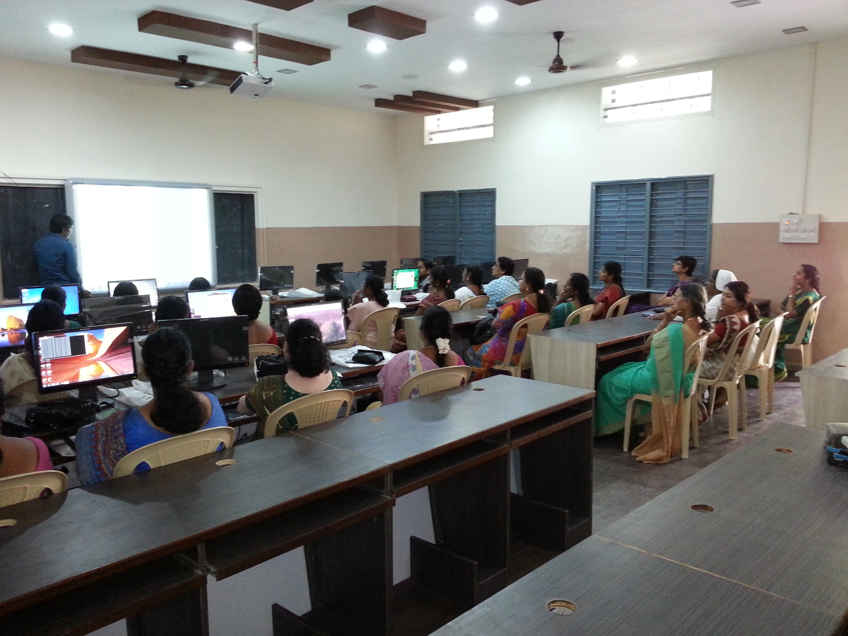
AUXILLIUM COLLEGE
Implemented Smartclass Room with Promethean Interactive Board, Visualizer and SONY LCD Projector.
Lenovo Desktop Computers connected in LAN
LAN School Software
Teach more effectively by broadcasting the teacher screen to the rest of the class. Select students’ screens to showcase their work. Easily co-browse the internet, so students go exactly where you do. Distribute polls or quick quizzes and share instant results with the class. Use remote control for quick assistance to students.

Slide 4
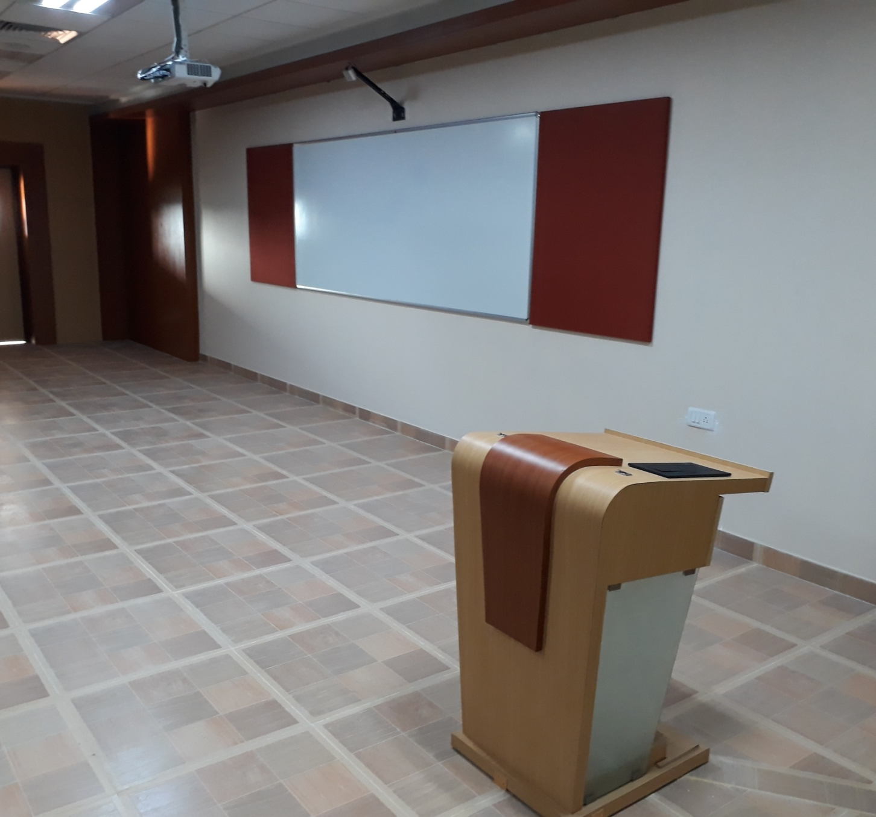
VIT UNIVERSITY
The Smart Classroom is Implemented with EPSON EB535W Short Throw Projector and Interactive Board
Crown Amplifier, JBL Speakers, Allen Heath Mixer Board , Shure Wireless Lavalier Microphone and Podium Microphone were Installed

Slide 5
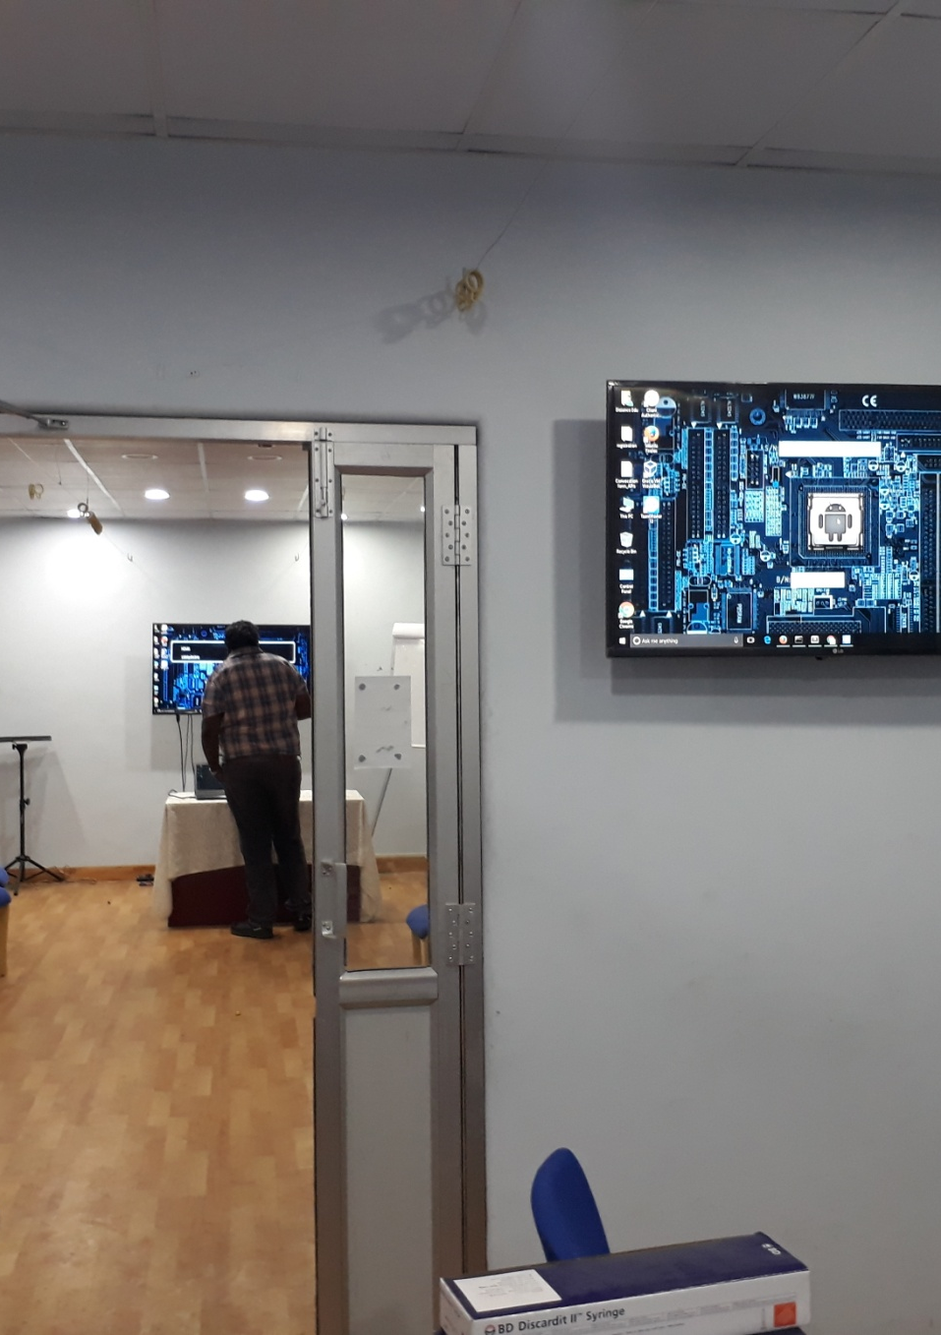
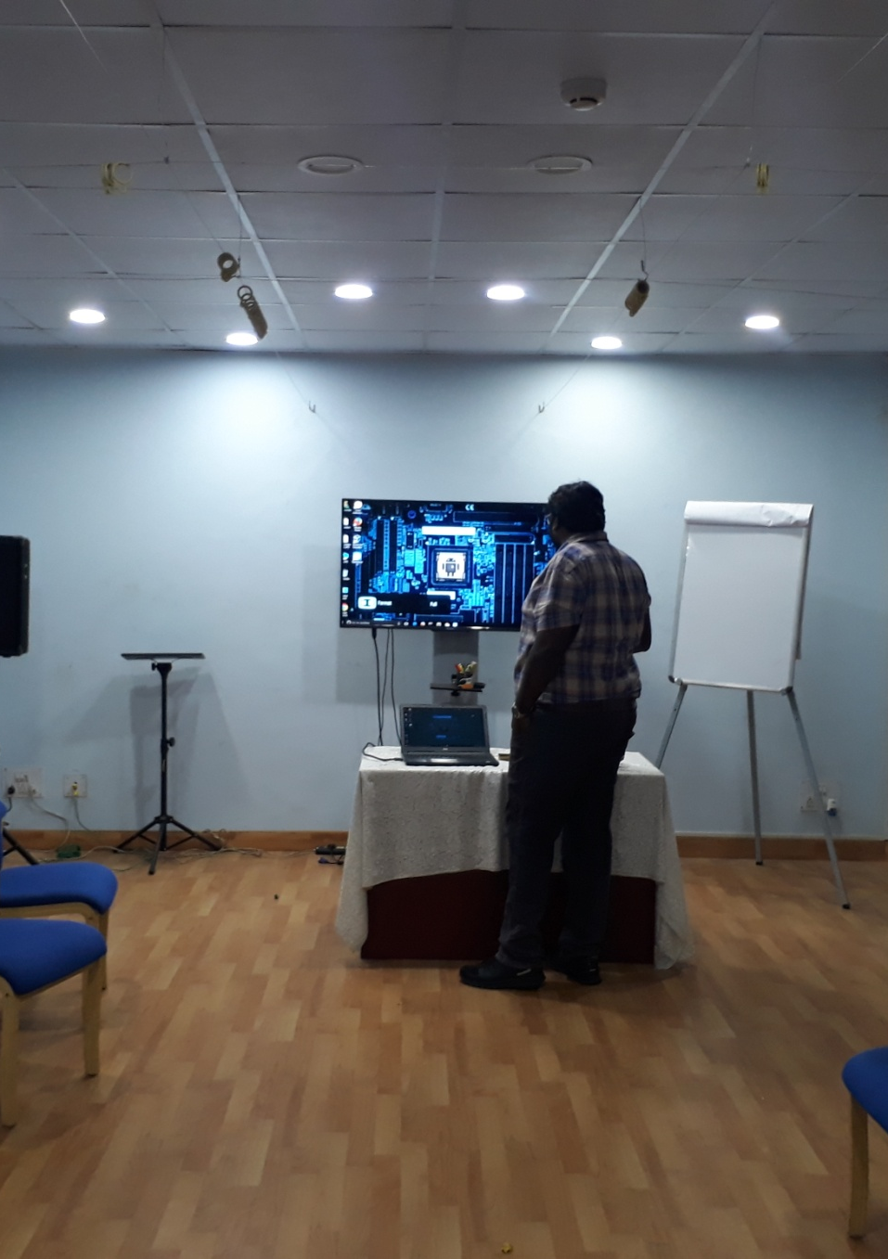
CMC
DISTANCE EDUCATION DEPARTMENT
A personalised solution is implemented according to our customer requirement where smart class room communication is done on the basis of one to many classrooms.
Also provided Audio solution by installing Crown amplifiers, JBL Speakers ,SoundCraft Mixer Board and Shure microphones

Slide 6
THANK YOU

